Slide 1
An Oasis or Mirage: Analyzing food retailing options in the St. Louis MSA, MO-IL
Stacey Brown Amilian, PhD
Southern Illinois University Edwardsville

Slide 2
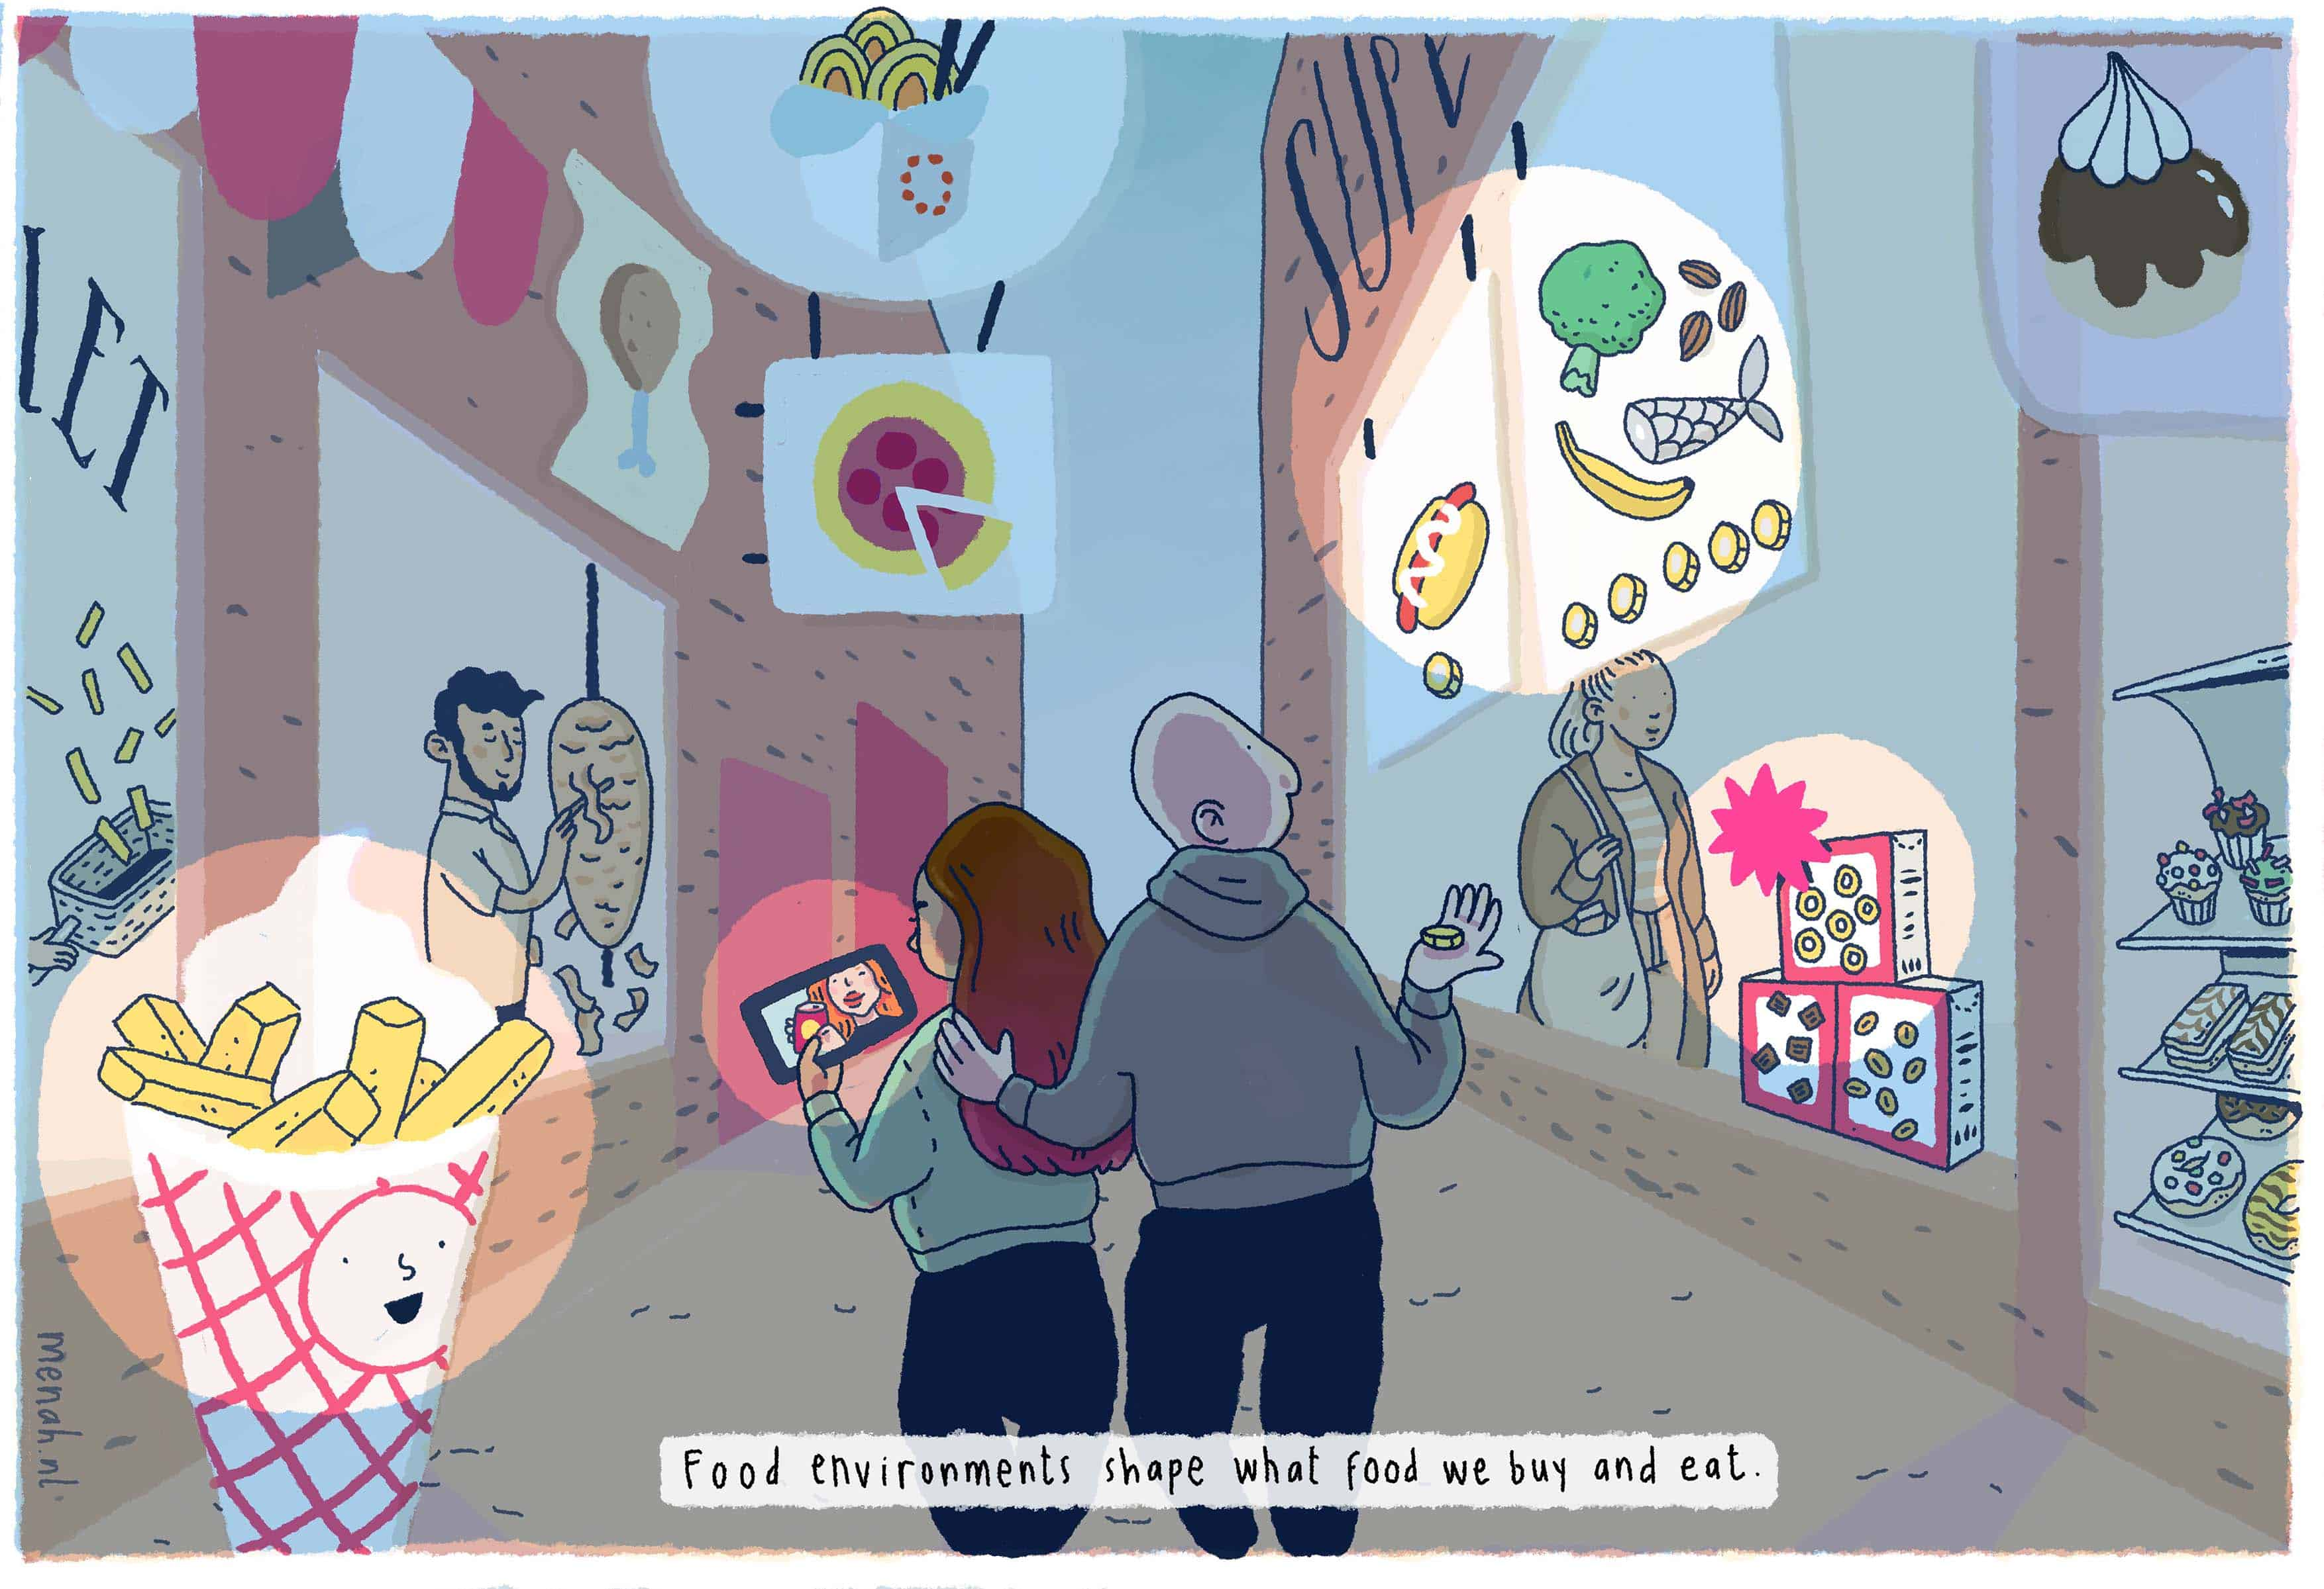
Introduction
Food environments shape what food we buy and eat.
Physical, economic, socio-cultural and policy surroundings, opportunities and conditions that affect the availability, accessibility, affordability and attractiveness of food and drinks.
https://epha.org/what-are-food-environments/

Slide 3
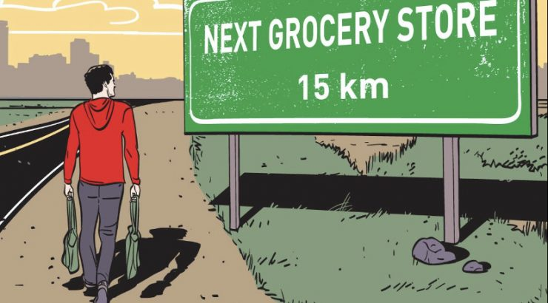
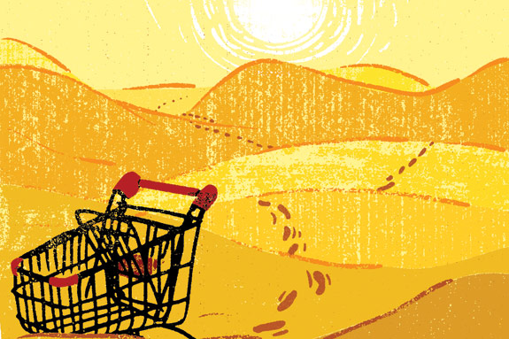
Introduction
Food deserts are defined as parts of the country without fresh fruits, vegetables and other healthful whole foods, usually found in impoverished areas¹.
These areas lack
Grocery stores
Farmer’s markets
Healthy food Providers

Slide 4
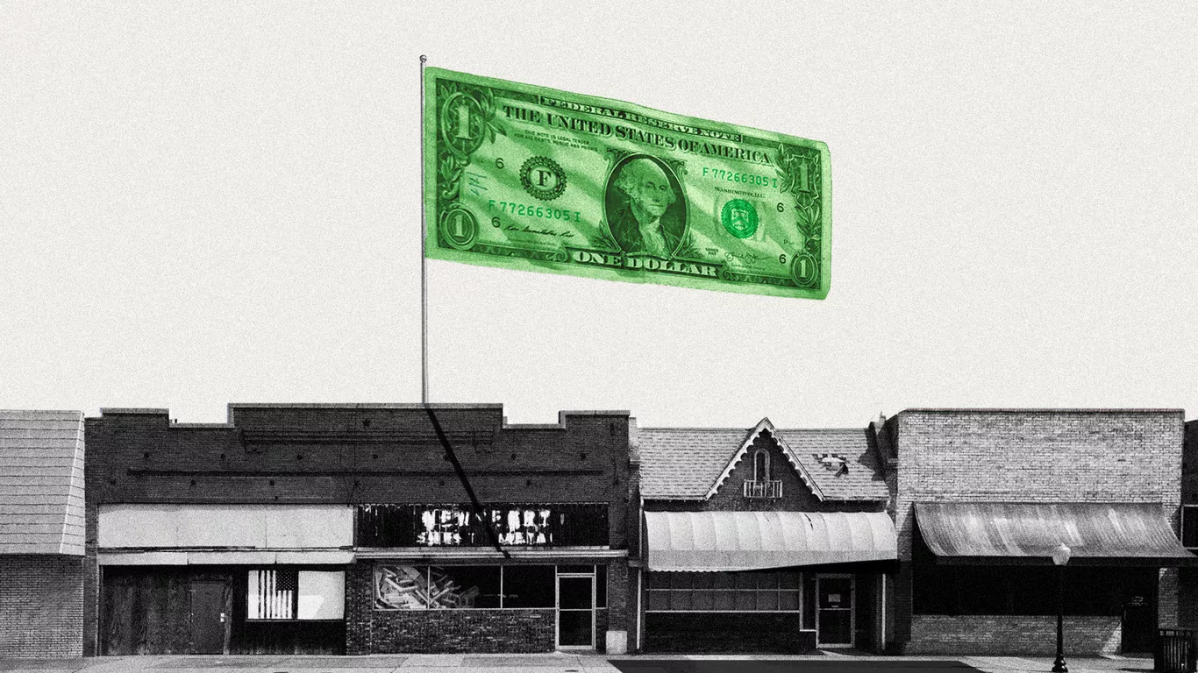
Food Environment Research
Most research focuses on supermarkets and fast food options
Li & Ashuri 2018; Wilkins et al. 2017; Barnes et al. 2016; Moudon et al. 2013; Rundle et al. 2009
Two national indices
CDC Modified Retail Food Environment Index
USDA Food Desert Locator
What about other retailers?
Specifically dollar stores

Slide 5
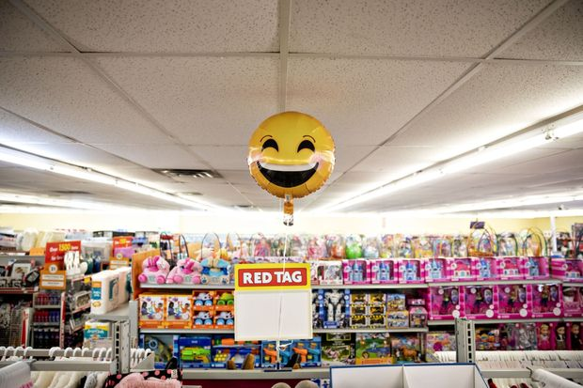
Dollar Stores
Dollar Store retailers open a new store every 4 ½ hours, an average of more than 5 a day! ³
Currently 30,000 dollar stores, with 20,000 more planned!
More dollar stores than all Walmarts and Starbucks combined³
Dollar Tree & Family Dollar had quarter-to-date same store sales up by 7.1% and 14.4%, respectively for March 2020³
https://www.barrons.com/articles/dollar-tree-and-family-dollar-are-stocks-to-buy-ahead-of-earnings-analyst-says-51590577200

Slide 6
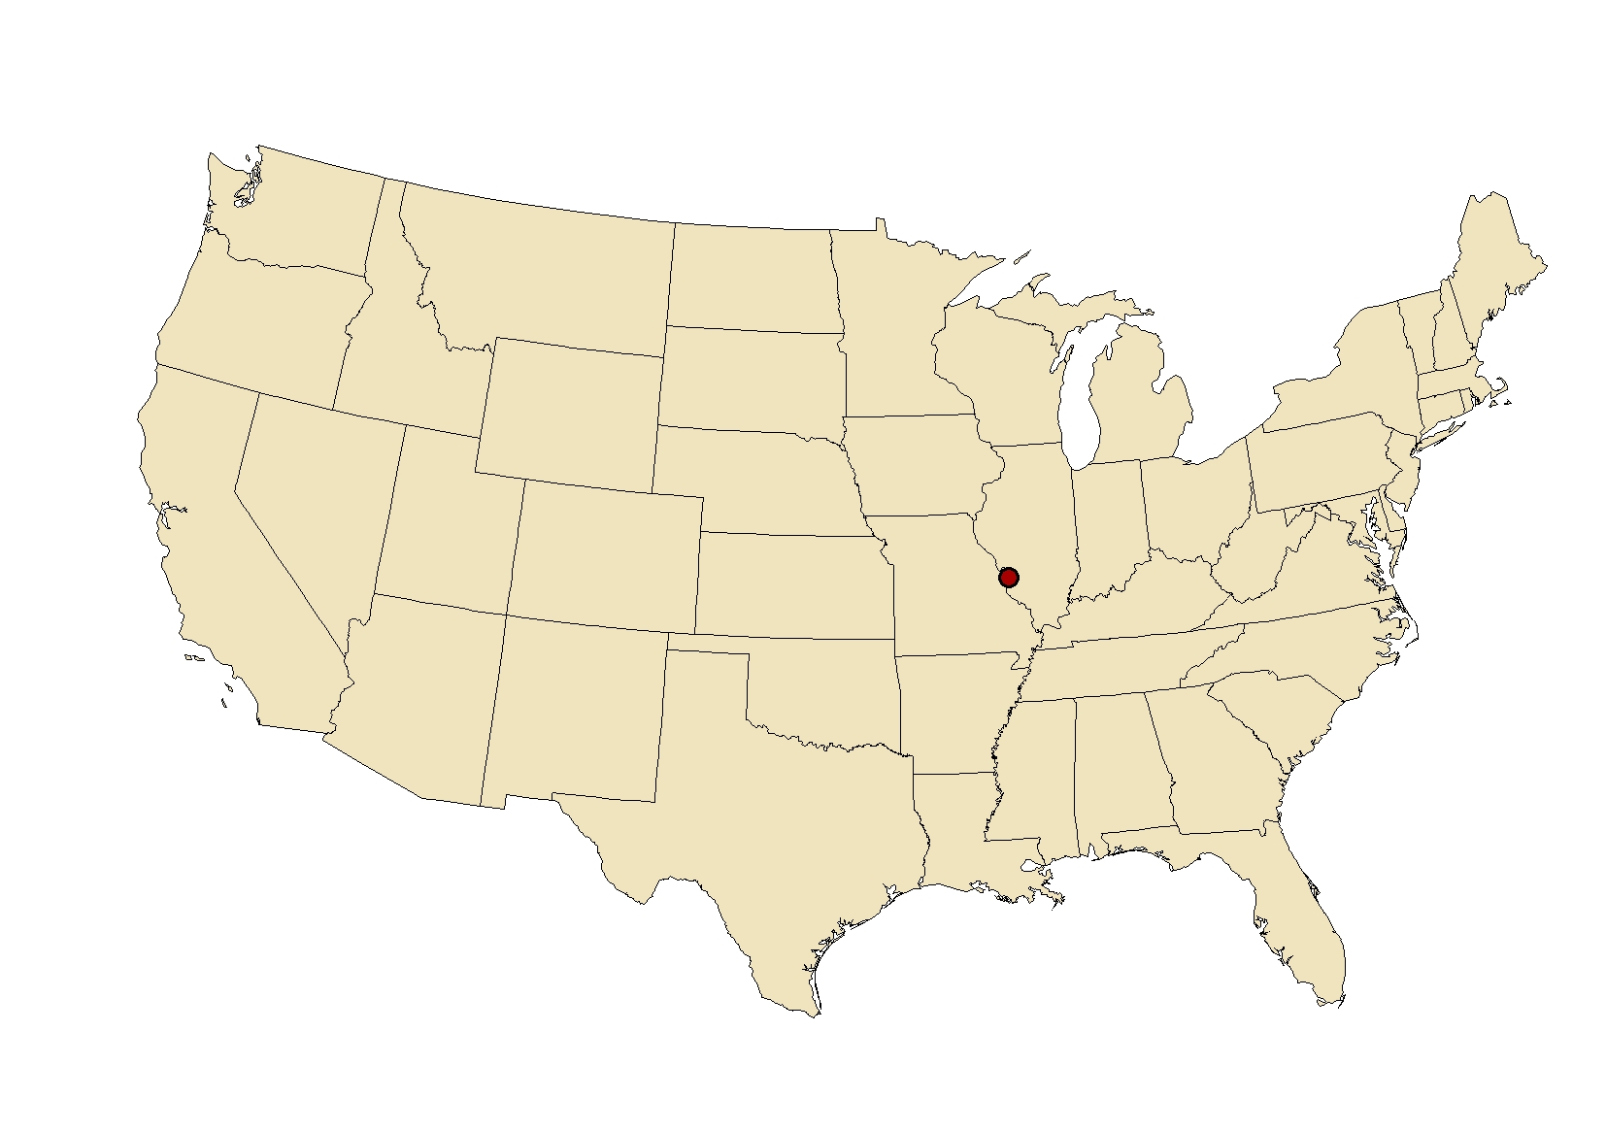
Objectives
Analyze the St. Louis MSA to determine:
(1) What does the food environment look like in St. Louis?
(2) How does the location strategies of supermarkets and dollar stores vary?
(3) Are dollar stores filling the void in food deserts?

Slide 7
USDA Food Access Research Atlas
Maps food access indicators for census tracts to the nearest supermarket.
Low Income and low access within 1 and 10 miles
66 tracts out of 553 are labeled as food deserts
https://www.ers.usda.gov/data-products/food-access-research-atlas/about-the-atlas/

Slide 8
Modified Retail Food Environment Index
Measures the number of healthy and less healthy food retailers within census tracts across each state
Healthy food = supermarkets, larger grocery stores, supercenters, produce stores
Less Healthy food = fast food restaurants, small grocery stores, and convenience stores
STL MSA Tracts:
Average 7.36
Highest is 50
Food Desert Tracts Only: Average score 6.16
Highest is 25

Slide 9
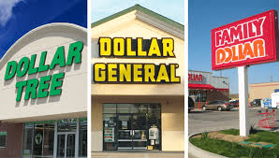
Methods
Addresses of all supermarkets and dollar stores
Aided by two undergraduate researchers throughout 2020
Reviewed by graduate student in December 2020
Population Weighted Centroids
Near tool

Slide 10
Food Retailer Analysis

Slide 11
Food Retailer Analysis

Slide 12
Food Deserts & Retailer Analysis

Slide 13
Grocery Store Analysis
264 grocers
42 Aldi
25 Dierberg’s
10 Ruler Foods
33 Save A Lots
78 Schnuck’s
23 Targets
4 Trader Joe’s
34 Walmart’s
3 Whole Foods

Slide 14
Grocery Store Analysis
264 grocers
42 Aldi
25 Dierberg’s
10 Ruler Foods
33 Save A Lots
78 Schnuck’s
23 Targets
4 Trader Joe’s
34 Walmart’s
3 Whole Foods

Slide 15
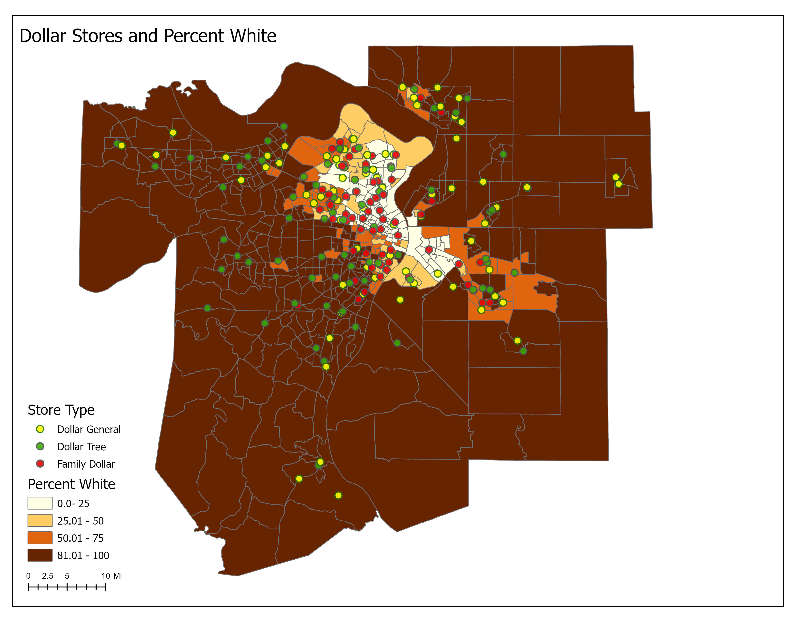
Dollar Store Analysis
231 dollar stores
82 Dollar General
76 Dollar Tree
73 Family Dollar

Slide 16
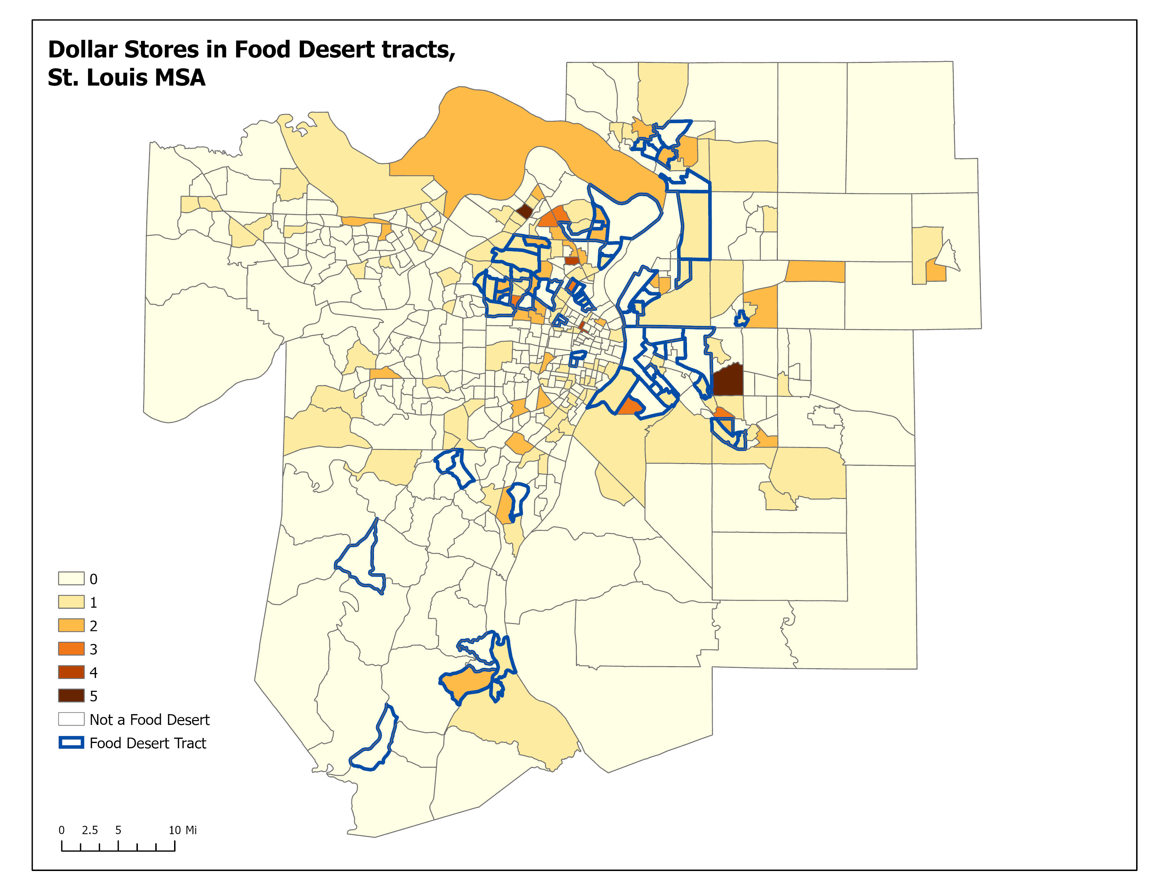
Dollar Store Analysis
231 dollar stores
82 Dollar General
76 Dollar Tree
73 Family Dollar

Slide 17
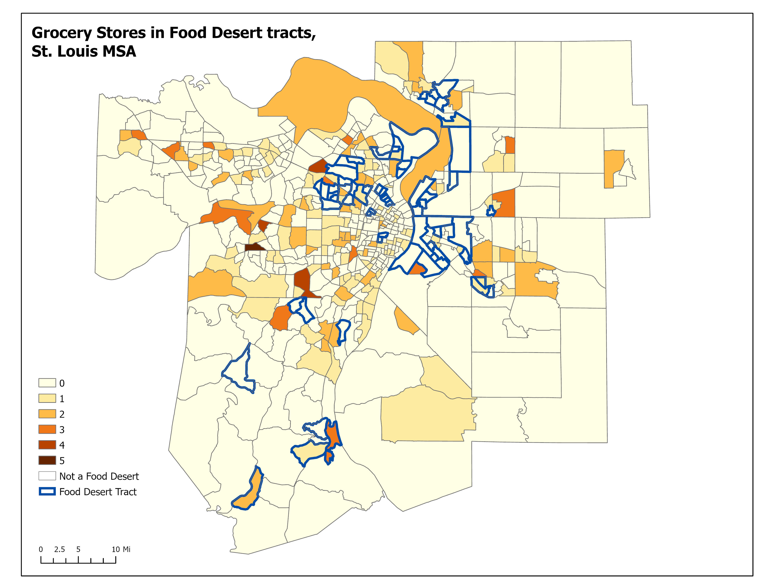
Dollar Stores vs. Grocery Stores in Food Deserts

Slide 18
Variables | All Tracts | Zero Stores | One Store | Two Stores | Many Stores
Total Pop | 4,496 | 4,236 | 4,314 | 4,784 | 5,193
Median Age | 39.4 | 39.6 | 39.1 | 38.93 | 39.78
Pct White | 68.6 | 69.7 | 66.9 | 67.6 | 68.97
Pct Black | 25.4 | 24.7 | 27.2 | 25.5 | 25.3
Pct Hispanic | 3.1 | 3.1 | 2.98 | 3.2 | 3.1
No HS | 9.3 | 9.2 | 9.4 | 8.97 | 9.5
Median income | $32,898 | $33,156 | $32,398 | $34,094 | $31,148
Pct Poverty | 14.2 | 14.4 | 14.2 | 13.2 | 14.2
Distance to Dollar Store (mi) | 1.56 | 2.08 | 1.07 | .98 | .78
Distance to Grocery (mi) | 1.47 | 1.93 | 1.18 | .82 | .72
mRFEI | 7.36 | 6.48 | 7.89 | 8.24 | 9.26
# of tracts | 553 | 285 (51.5%) | 142 (25.7%) | 78 (14.1%) | 51 (9.22%)

Slide 19
Variables | All Tracts | Zero Stores | One Store | Two Stores | Many Stores | Food Desert Tracts
Total Pop | 4,496 | 4,236 | 4,314 | 4,784 | 5,193 | 3,749
Median Age | 39.4 | 39.6 | 39.1 | 38.93 | 39.78 | 36.68
Pct White | 68.6 | 69.7 | 66.9 | 67.6 | 68.97 | 45.67
Pct Black | 25.4 | 24.7 | 27.2 | 25.5 | 25.3 | 48.5
Pct Hispanic | 3.1 | 3.1 | 2.98 | 3.2 | 3.1 | 4.9
No HS | 9.3 | 9.2 | 9.4 | 8.97 | 9.5 | 15.55
Median income | $32,898 | $33,156 | $32,398 | $34,094 | $31,148 | $23,007
Pct Poverty | 14.2 | 14.4 | 14.2 | 13.2 | 14.2 | 24.3
Distance to Dollar Store (mi) | 1.56 | 2.08 | 1.07 | .98 | .78 | 1.14
Distance to Grocery (mi) | 1.47 | 1.93 | 1.18 | .82 | .72 | 1.58
mRFEI | 7.36 | 6.48 | 7.89 | 8.24 | 9.26 | 6.16
# of tracts | 553 | 285 (51.5%) | 142 (25.7%) | 78 (14.1%) | 51 (9.22%) | 66 (11.9%)

Slide 20
Conclusions
What does the food environment look like in St. Louis?
Wide variety of food options
Majority of tracts do not have a food store (51%), travel is needed.
(2) How does the location strategies of supermarkets and dollar stores vary?
Seems to congregate with one another in majority of cases
However, dollar stores are in areas where grocers do not locate
(3) Are dollar stores filling the void in food deserts?
No, very few dollar stores in the food desert tracts

Slide 21
Conclusions
Not every single retailer mapped
Future research will incorporate more food options
First analysis to review dollar stores alongside grocery options
Without looking at food deserts, most tracts are quite similar, however when you add in the food desert tracts, it is quite startlingly how different the demographics compare.

Slide 22
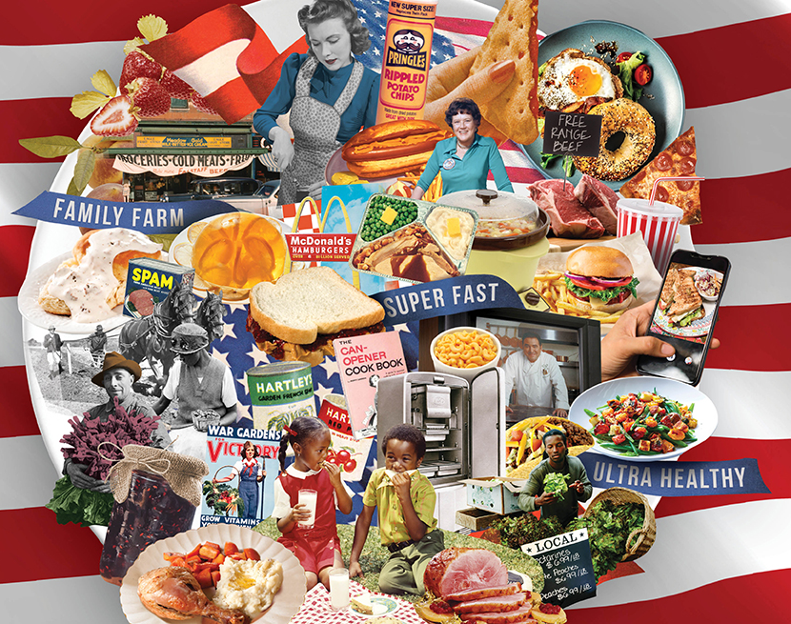
Thank you!
Please feel free to email me if you have further questions:
stabrow@siue.edu
Image source

