Slide 1
Incorporating E-commerce into Retail Location Models
Joris Beckers, Mark Birkin, Graham Clarke, Nick Hood,
Andy Newing, Ryan Urquhart

Slide 2
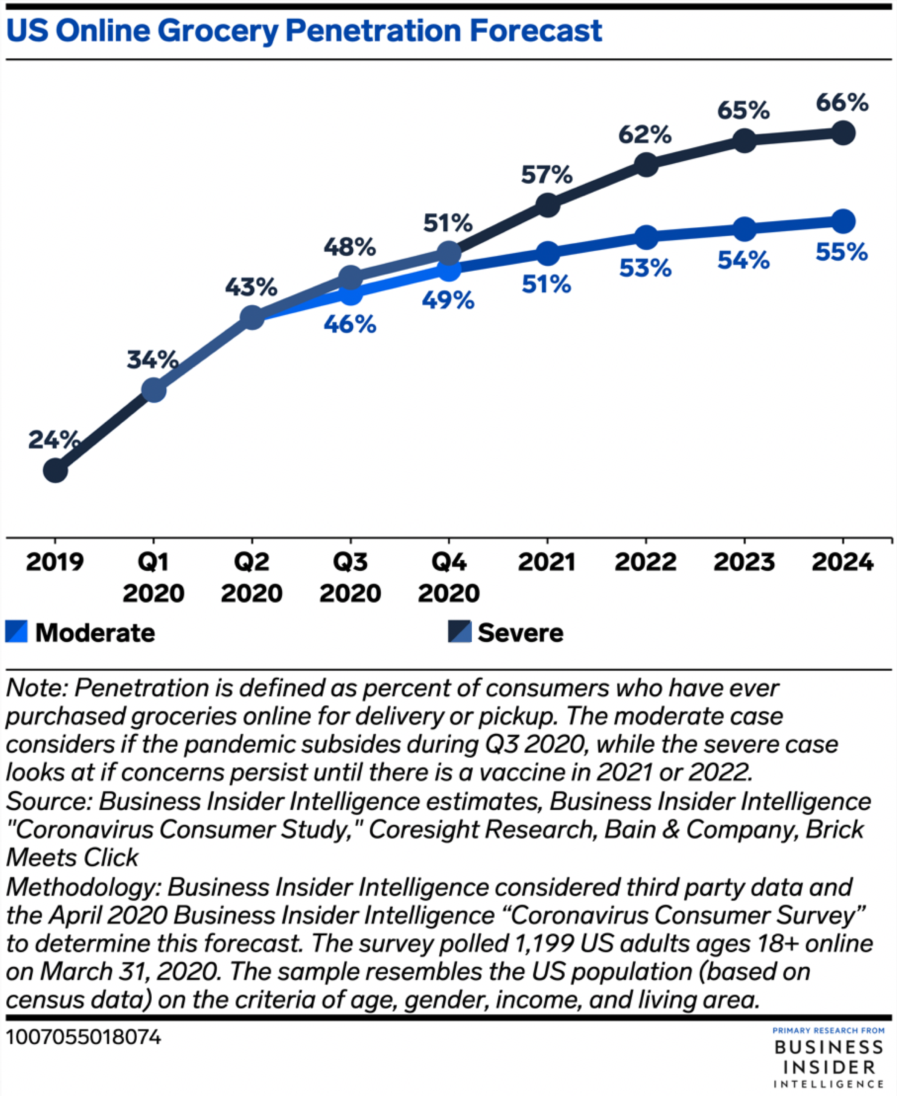
The grocery market is changing
Kantar, 2017
Reuters, 2021

Slide 3
This puts into question the relevance of traditional retail location models
Gravity-based spatial interaction models (Wilson, 1970)
Gaining popularity in the 1980s and 1990s (Wrigley, 1994)
Variety of improvements e.g. disaggregation, agglomeration, trip chaining (Arentze et al. 2005; Fotheringham, 1986; Newing et al., 2015)
Whith e-commerce as ‘the death of distance’, what role for SIM?

Slide 4
E-commerce is a spatial activity
Higher uptake in major urban areas (Anderson, 2003)
Higher uptake due to poor accessibility (Anderson, 2003)
Age, gender and affluence related (Beckers et al., 2018; Clarke et al., 2015; Hood et al., 2020)
Brand loyalty remains important (Kirby-Hawkins et al. 2019)
Notes:
We do see a role for SIM because e-commerce is a spatial activity

Slide 5
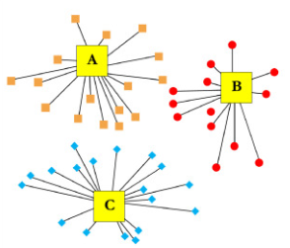
Updating the SIM
Traditional SIM
Step 1: Modifying demand term
with
$$S_{ij}^{k}=A_{i}^{k}{ O}_{i}^{k} W_{j}^{α^{k}} \exp^{{−β}^{k}c_{ij}}$$
 | $$O_{i,online}^{k}=f\left(age, income, c_{ij^{∗}}\right)$$ | eq. 2
 | $$O_{i,online}^{k}= B_{i}P_{i}Df(c_{ij^{∗}})$$
with | $$O_{i,online}^{k}≤{ O}_{i}^{k}$$
Zaharudin et al., 2021
$$f\left( c_{ij^{∗}}\right)={H_{i}}^{−γ}$$
$$H_{i}=\sum_{j^{∗}}{W_{j^{∗}} \exp^{(−c_{ij^{∗}})}}$$

Slide 6
Updating the SIM
Traditional SIM
Step 2: Modifying allocation - Kirby-Hawkins et al. (2019) showed a logarithmic relation between a retailer’s physical store provision and its local online market share
$$S_{ij}^{k}=A_{i}^{k}{ O}_{i}^{k} W_{j}^{α^{k}} \exp^{{−β}^{k}c_{ij}}$$
$$S_{i}^{kr}={ A_{i}^{k}O}_{i,online}^{k}W^{rα^{k}}{ln\left(d_{{ir}^{∗}}\right)}^{β}$$

Slide 7
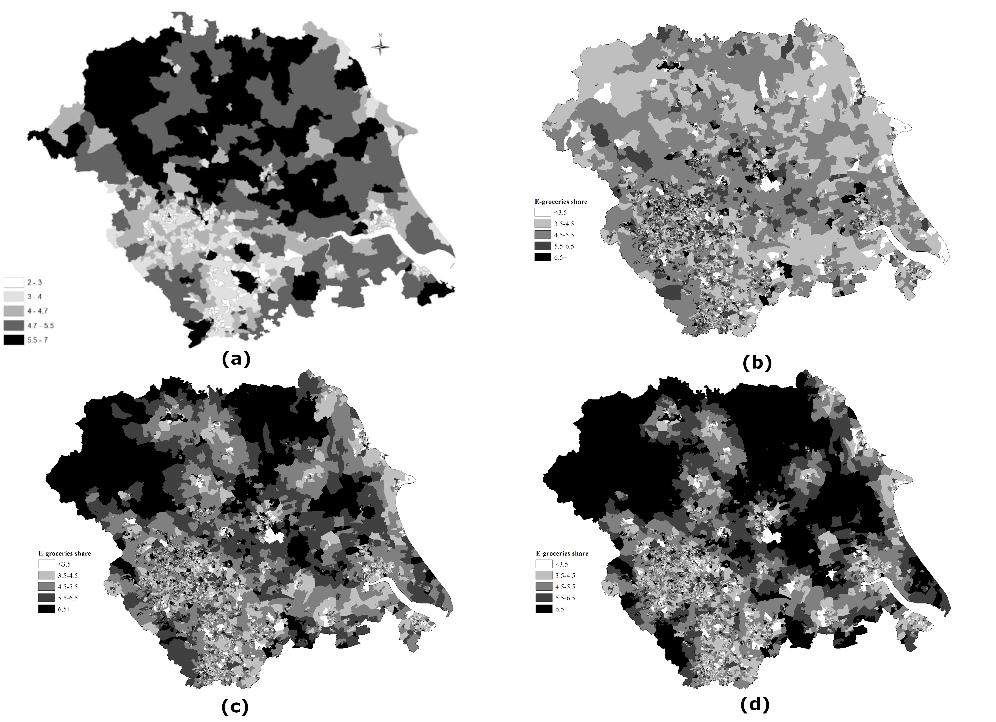
Results: efficiency hypothesis (γ)
Impact γ on e-groceries share
York
(a) CACI’s national on-line expenditure
profiles (Kirby-Hawkins et al. 2019)
(b) Model output with γ = 0.
(c) Model output with γ = 0.03.
(d) Model output with γ = 0.05
Leeds
Hull
Sheffield

Slide 8
Calibration of online demand
 | Expected share (BPS) | γ = 0 | γ = 0.03 | γ = 0.05 | γ = 0.07
Blue collar communities | 4.6 | 5.14 | 5.07 | 5.01 | 4.92
City Living | 5.65 | 6.13 | 5.75 | 5.46 | 5.12
Countryside | 5.35 | 4.66 | 5.46 | 6.15 | 7.01
Prospering Suburbs | 5.4 | 4.81 | 4.78 | 4.73 | 4.66
Constrained by circumstances | 4.2 | 4.44 | 4.29 | 4.15 | 3.99
Typical traits | 5.45 | 5.51 | 5.39 | 5.30 | 5.18
Multicultural | 4.5 | 5.41 | 5.04 | 4.76 | 4.45
Sum of squares |  | 2.2 | 0.9 | 1.4 | 3.8

Slide 9
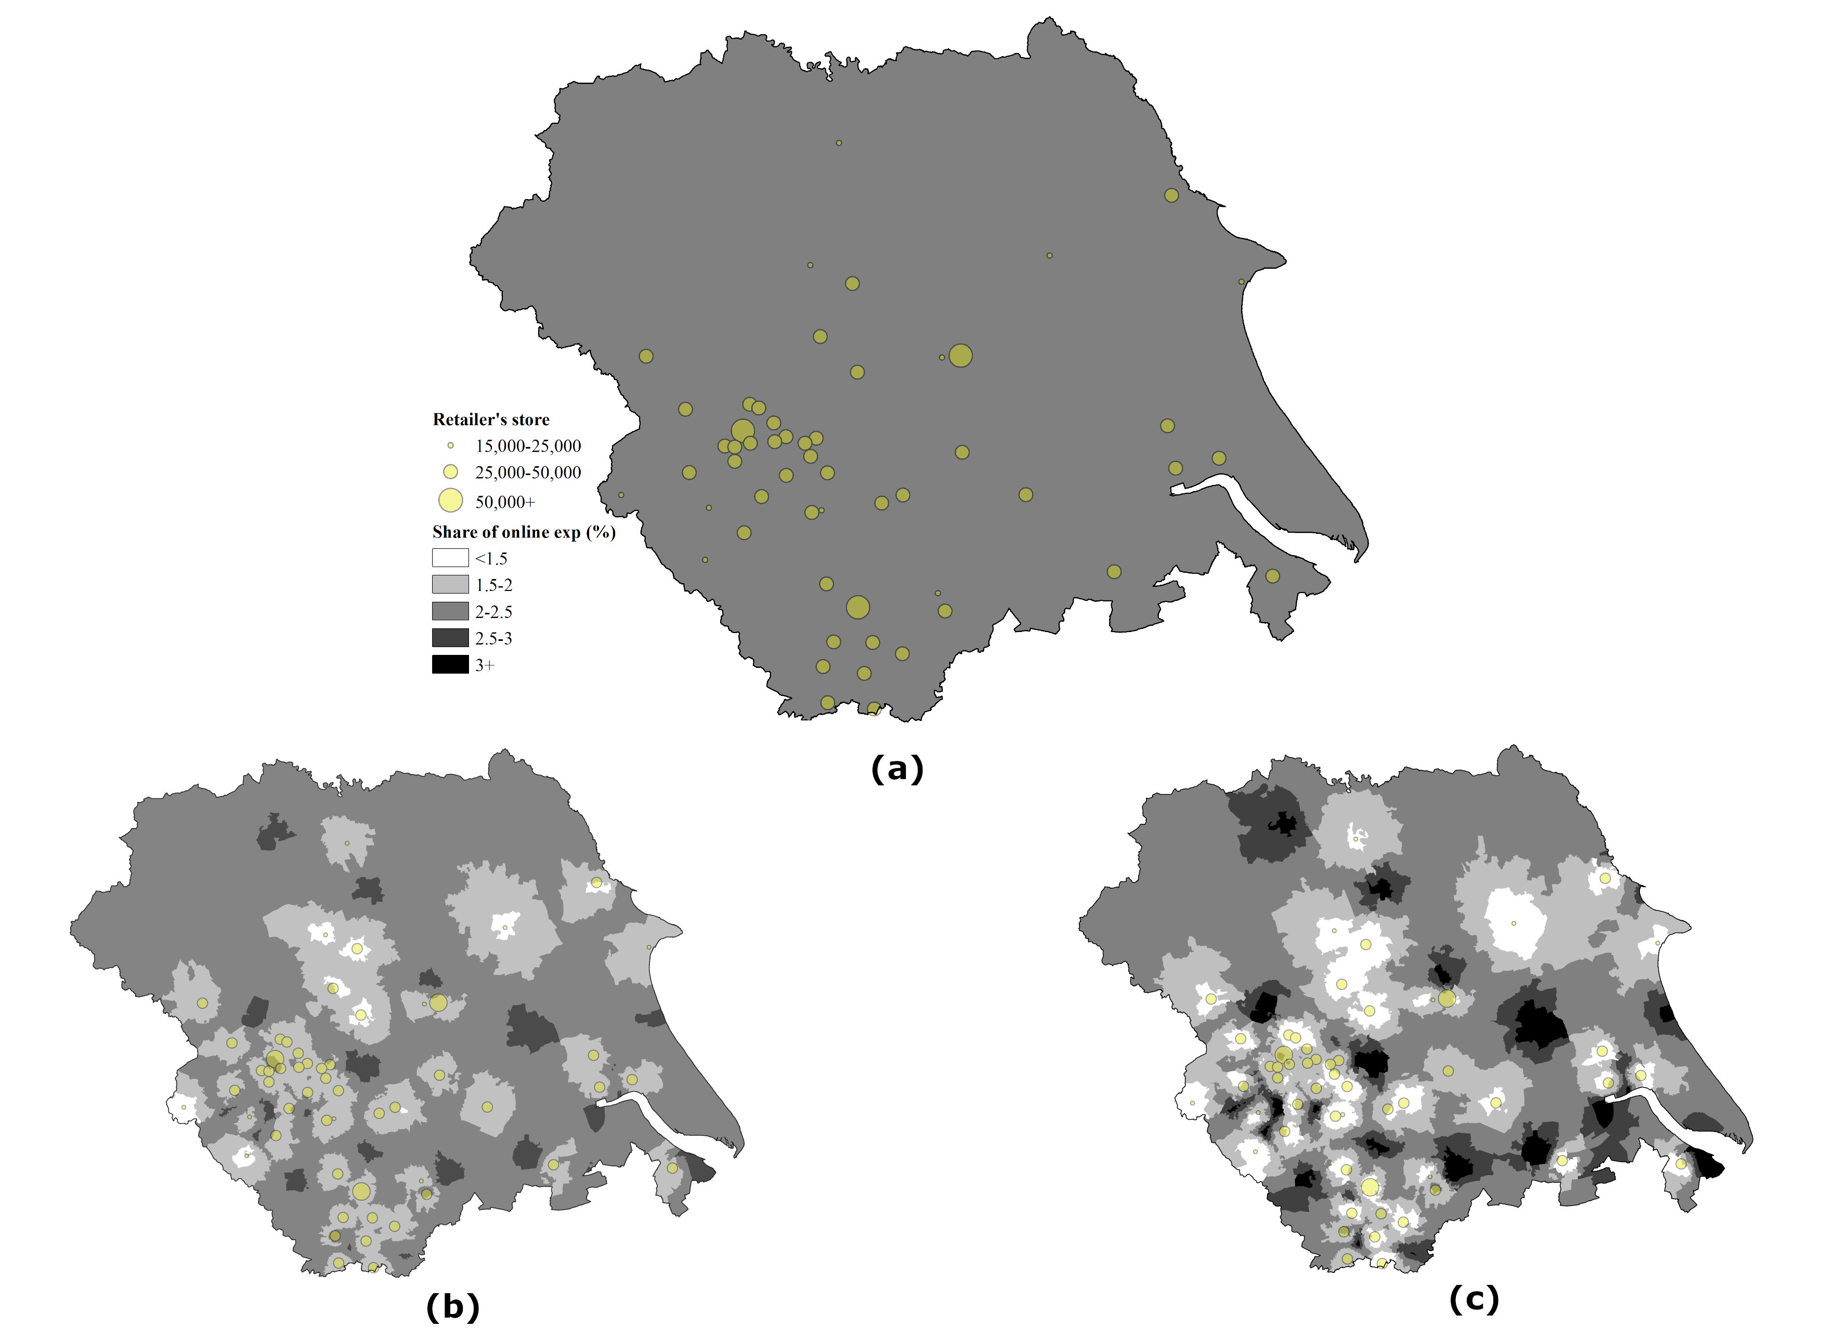
Results: Retailers brand loyalty (β)
Impact β on allocation of e-groceries
expenditure to one retailer.
Model output with β = 0.
Model output with β = 0.5
Model output with β = 1.

Slide 10
Conclusion on retail location
Updated SIM allows for modelling a double repulsion effect of physical store presence in the e-groceries context.
The location decision for the retailer now goes beyond minimizing the distance to its consumers while accounting for competition. Instead, the retailer has to balance gaining offline consumers with losing online consumers.

Slide 11
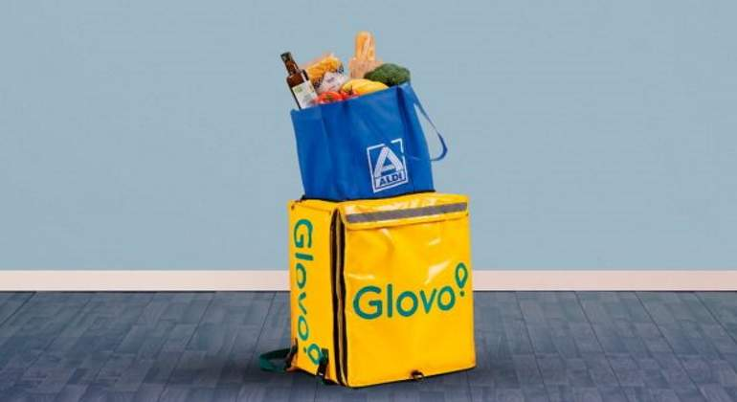
But what with logistics?
Urban areas provide shorter distances and higher densities.
RTE, 2020
The Irish Times, 2020

Slide 12
Email: joris.beckers@uantwerpen.be | Twitter: @j_beckers

