Slide 1
That’s a Relief: Assessing Landform Clarity and Aesthetic Preference in Terrain Maps
Nathaniel A. K. Douglass
University of Oregon
Spatial Cognition, Computation, and Complexity Lab
Saturday 10th, 2021
AAG 2021
Notes:
Introduce myself: NAthaniel Alexander Kameleokalani Douglass, 2nd year Master's students at the University of Oregon working with Dr. Carolyn Fish in the Spatial Cognition, Computation, and Complexity Lab
Today I will be speaking about the preliminary findings and development of research I am conducting for my Master's Thesis titled ____

Slide 2
Introduction:
Maps can be more than just tools for navigation, for when you are lost, but works of art worth getting lost in reading.
Notes:
To begin,:
preface research through the lens of a philosophy that many cartos have
"Maps can be more than just tools for navigation for when you are lost, but works of art worth getting lost in reading" (Caquard, 2011; Harmon and Clemans, 2009)
This statement touches on a fundamental principle of cartography:
- map making is both the science and art of representing space.
- Imhof and others:
“maps are as much about providing aesthetic appreciation for the landscape as they are about accurately representing space/place.

Slide 3
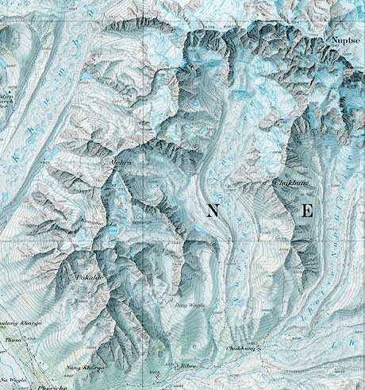
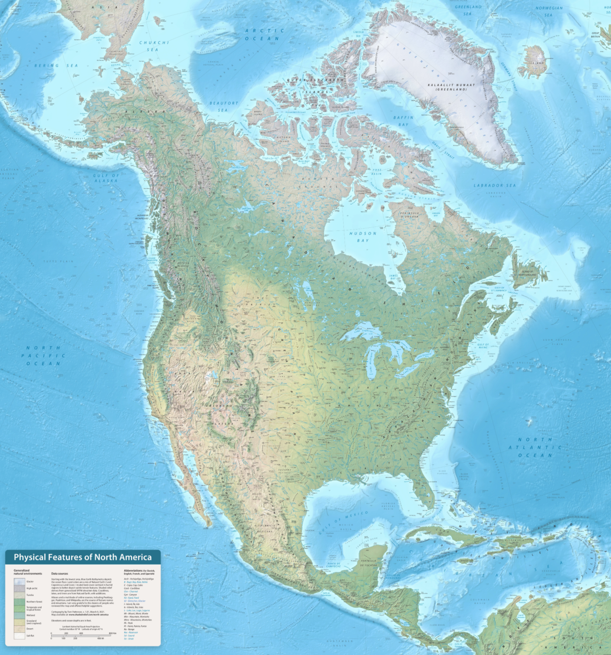
Introduction:
“Mount Everest” (section) © National Geographic Society, original scale 1:50,000 (size 60 x 93 cm), 1988.
“Physical Map of North America, Tom Patterson, (size 45.5 x 47" in.), 2021.
Notes:
Esspecially regarding maps that depict terrain and the physical environment –
plethora of ways to represent terrain,
cartographers are challenged with how to visualize the landscape using variety of techniques
rtraditional manual relief techniques
to more recent algorithmic relief techniques
photo editing software such as Photoshop
Both:
with the intent to strike a balance between clarity, beauty, and realistic aesthetic representation of geography.

Slide 4
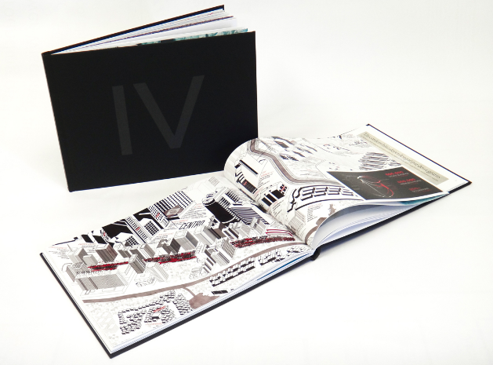
Content Analysis: Atlas of Design Vol 4 and 5
63 Maps in Total
https://atlasofdesign.org/
Notes:
To better understand this relationship between aesthetics and terrain representation:
Content analysis
two volumes of the Atlas of Design
a publication made possible by the North American Cartographic Information Society dedicated showcasing some of the world’s most beautiful and intriguing cartographic designs.

Slide 5
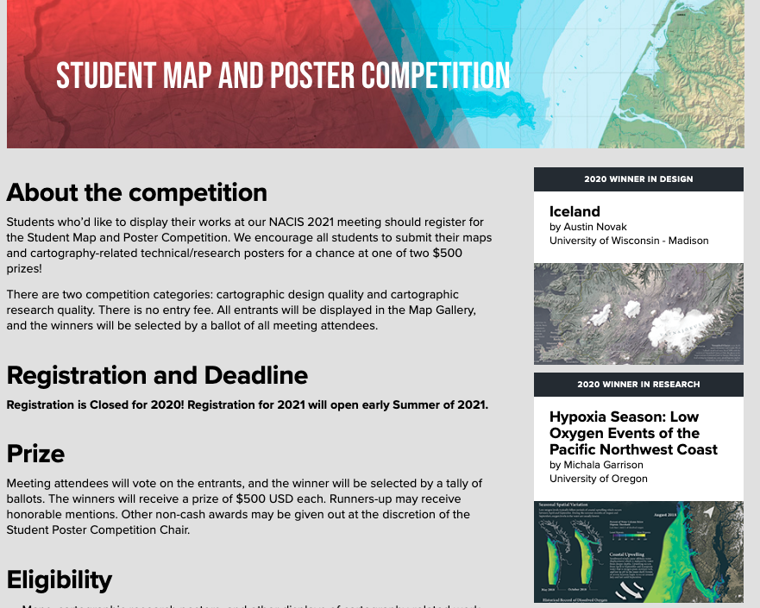
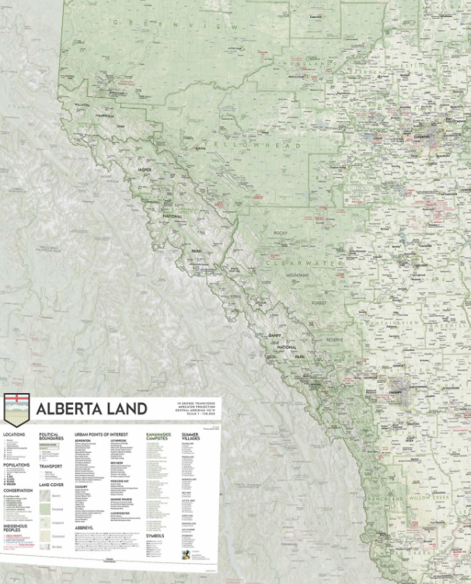
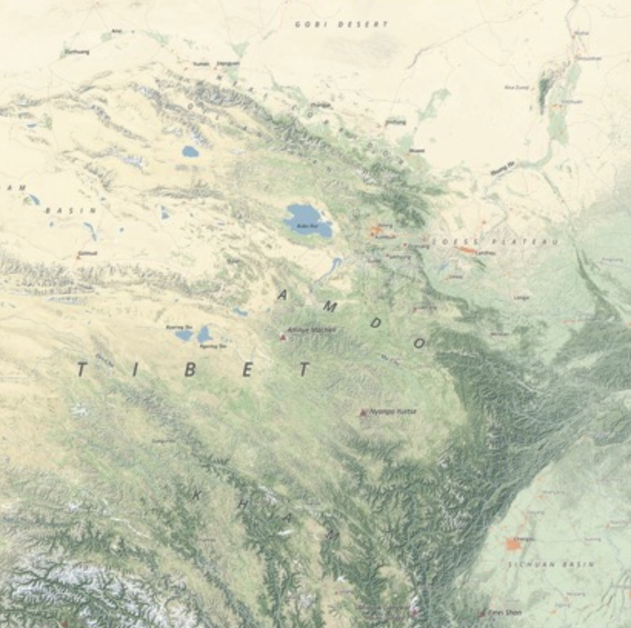
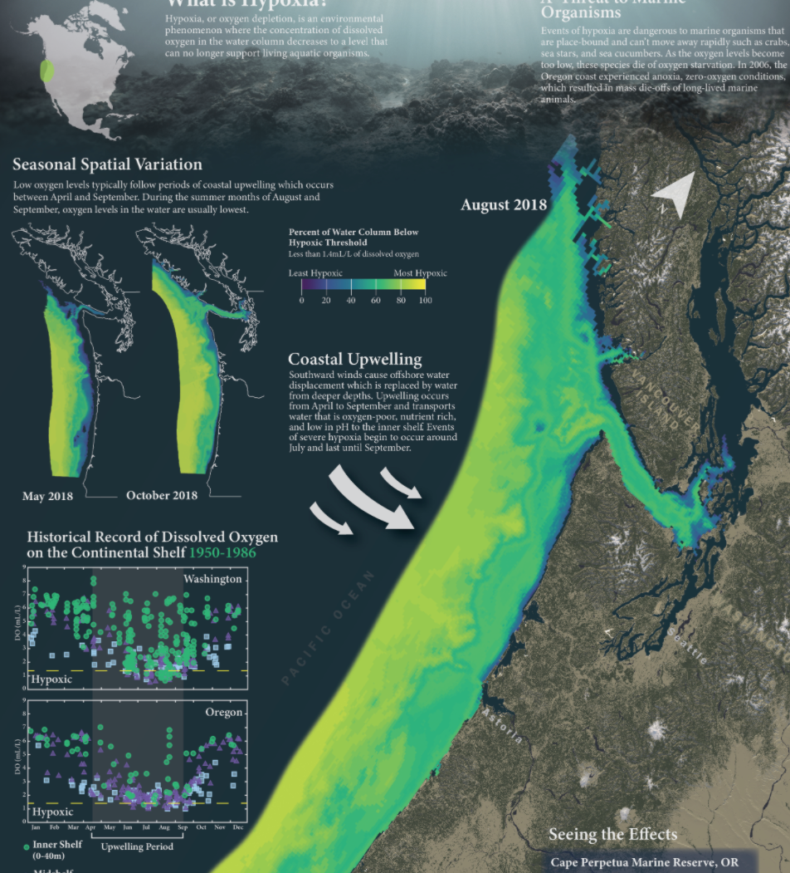
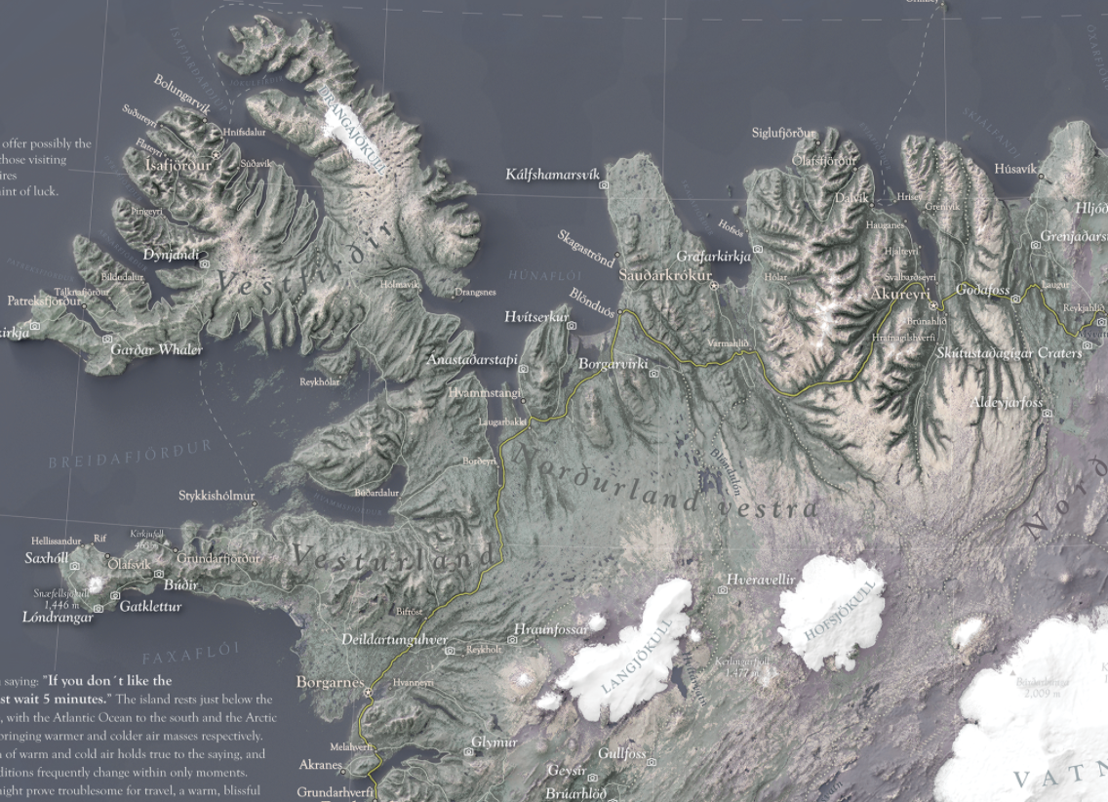
Content Analysis: NACIS Student Award Winning Maps
17 Maps in Total
https://nacis.org/awards/student-map-and-poster-competition/
Notes:
Additionally:
Entire collection of award winning student maps and posters from NACIS over past 11 years
To understand terrain techniques
Since intereste din aesthetics:
I thought the best place to search for best practices:
these two sources as they are highest standerd of cartographic excellence since
deemed most succesful for their design qualities by the general cartographic community.

Slide 6
Content Analysis:
 | # of Maps | Terrain Representation
NACIS | 17 | 12 (70%)
Atlas of Design | 63 | 34 (54%)
Total | 80 | 46 (58%)
Notes:
The results showed that out of eighty maps total in the collection, 46 of them used shaded relief or some form of terrain representation.

Slide 7
Content Analysis: Shaded Relief
Analytical Shaded Relief Blender Manual
RICK ZEEB, MAGNATERRA CARTOGRAPHIC
MARKUS HAUSER—ORELL FÜSSLI KARTOGRAPHIE AG
JEFF CLARK — CLARK GEOMATICS
Notes:
Of the maps that used shaded relief:
A majority of them used a standard analytical shaded relief technique
a handful used a popular relief technique generated from a 3-D rendering software called Blender
and one used a traditional manual shaded relief.

Slide 8
Content Analysis: Thematic Terrain Elements
Hypsometric Tinting Landcover Orthographic Imagery
EVAN APPLEGATE – RADIANT MAPS
JOHN NELSON -ESRI
Aaron Taveras - ANAGRAM
Notes:
Additionally these maps were most commonly paired with:
hypsometric tinting, landcover, or orthoimagery (sometimes a pairing of the latter two),
suggesting that the successful use of relief and terrain mapping requires an understanding of the interplay between these shaded relief and thematic terrain elements.

Slide 9
Research Objective
RQ1: How do manual and analytical shaded relief techniques influence landform clarity in terrain maps that incorporate hypsometric tinting, landcover, and orthoimagery?
RQ2: How do manual and analytical shaded relief techniques influence aesthetic preference in terrain maps that incorporate hypsometric tinting, landcover, and orthoimagery?
Notes:
The content analysis directly informs my research objective which is to
examine both traditional and contemporary relief shading techniques found in terrain maps,
- with aims to empirically assess map reader perception.
Specifically, this research investigates:
the way three relief shading techniques (Manual relief, analytical multidirectional relief, and Blender generated relief)
influence landform clarity and overall aesthetic appeal, when blended with hypsometric tinting, landcover, and orthoimagery.
The following research question will thus drive the remainder of my research

Slide 10
Methodology
The research questions are answered through a two-part user study experiment.
RQ1 will be examined during part one of the experiment, where participants will rank the clarity of three landforms as they appear across nine permiatations of same location.
RQ2 will be investigated during the second part of the user study, where participants will be asked to rate each terrain map permutation based on two aesthetic qualities: beauty and realism.
Notes:
In order to answer these questions:
I plan to conduct a two-part user study experiment
1 – participants rank the clarity of landforms
2 – overall aesthetic appeal. Beuty and realism

Slide 11
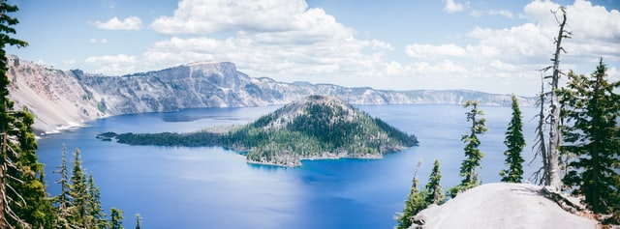
Stimuli Design
Crater Lake, OR, USA
“Crater Lake inspires awe” – NPS Website
Photo by James Fitzgerald on Unsplash, shaded relief by Bill von Allmen on shadedreliefarchive.com
Notes:
Crater Lake is:
Volcanic coldera
Located in southern Oregon
Deepest lakes in the USA
- “Inspires awe” NPS
I chose Crater Lake as my stimuli map
Unique landforms
Recognizable shape
Available manual relief made possible by Tom Patterson and Bernard Jenny

Slide 12
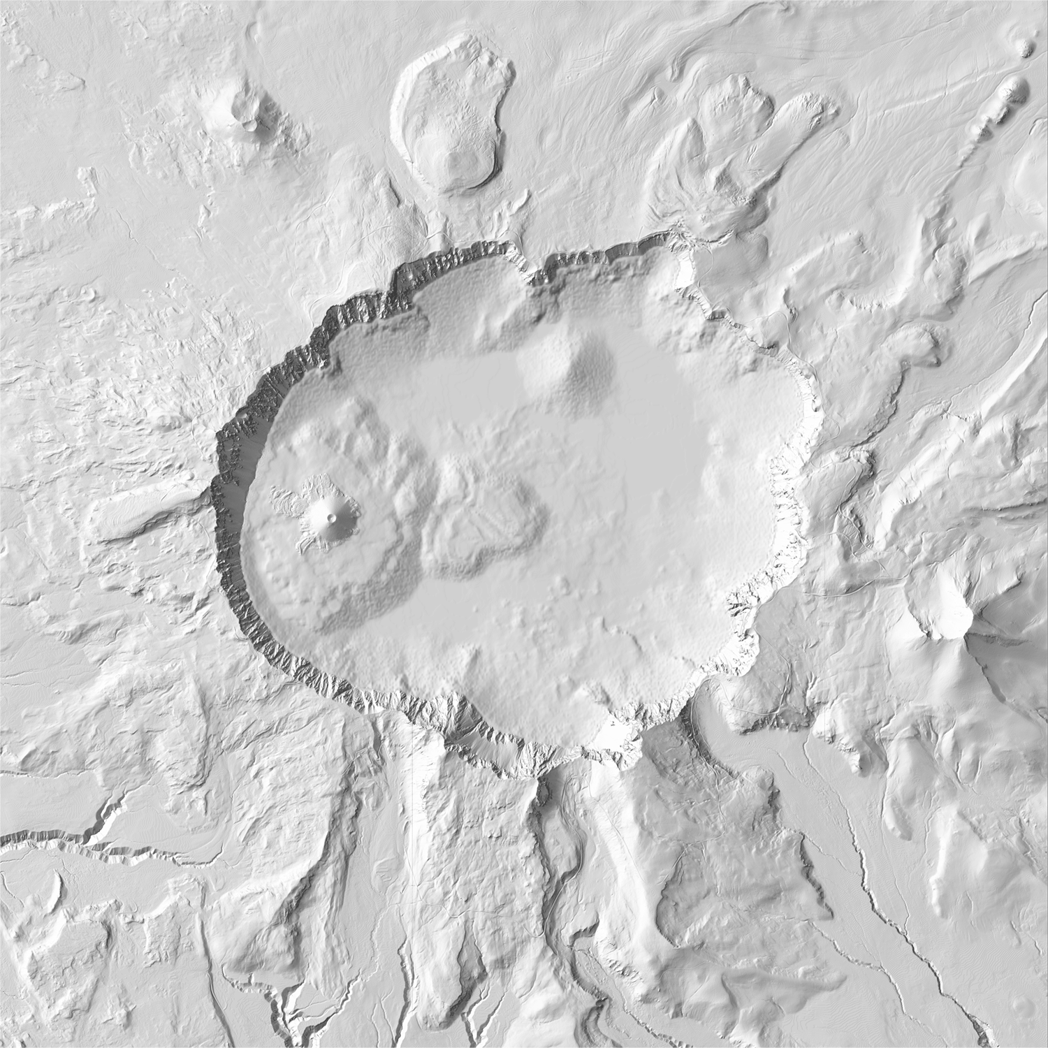
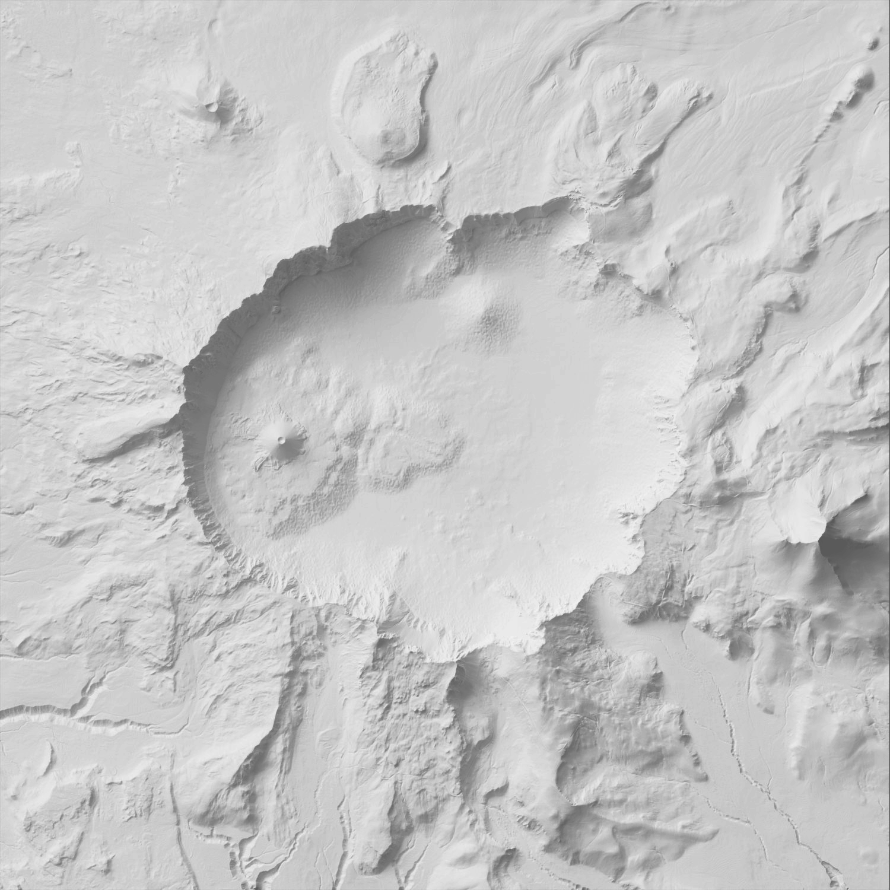
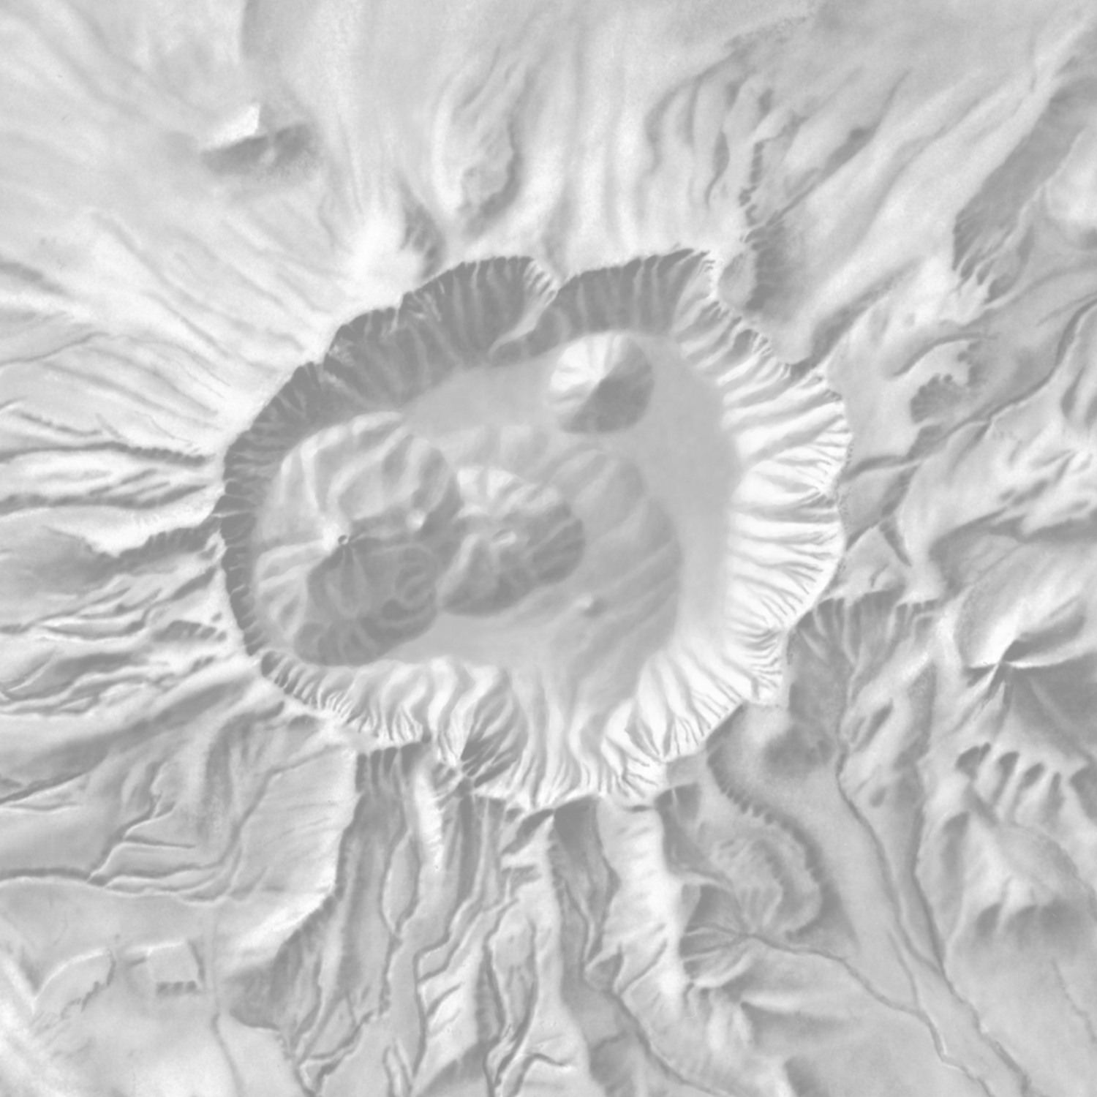
Shaded Relief
Multidirectional Blender Manual
DEM courtesy of http://shadedrelief.com/SampleElevationModels/ , Bathymetry generated from USGS
Notes:
I created three shaded relief maps – two anylytical from Sample Elevation Models for Evaluating Terrain Representation site and Bathy from USGS
Anylitical/Automated relief = Standard or Multidirectional Relief created from QGIS
Blender = relief created using Blender
Manual = Collected from Shaded Relief Archive

Slide 13
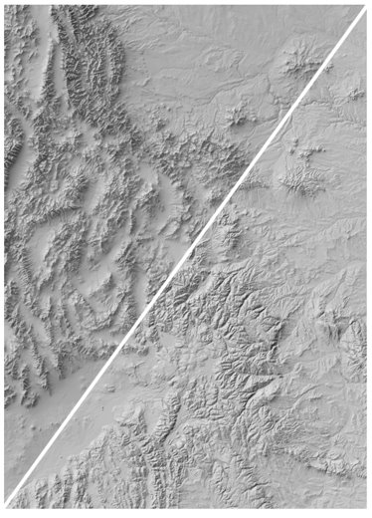
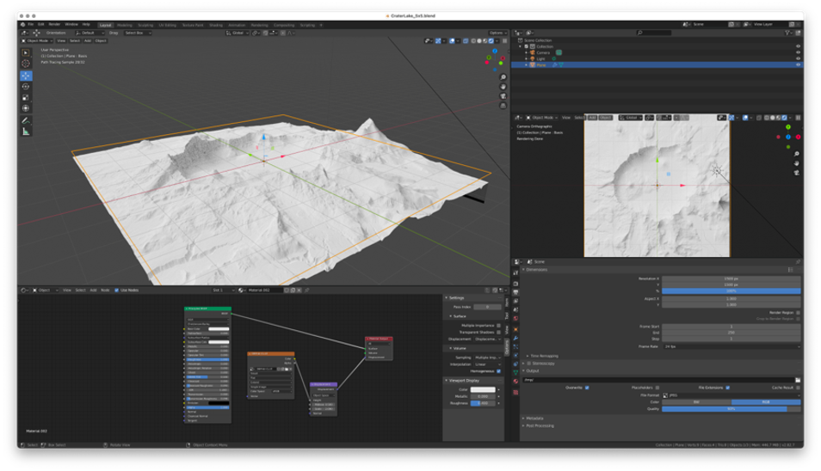
Blender
Blender
User interface of Blender
Blender vs. Standard Relief
Standard
https://somethingaboutmaps.wordpress.com/
Notes:
Blender is a 3D rendering software
Recently it has increased in popularity
You can’t scroll twitter withought seeing a blender relief
Tutorial courtesy of Daniel Huffman
Blender provider more sophisticated relationships with diffuse light sourcing
More photorealistic renderings
Greater depth of shadows

Slide 14
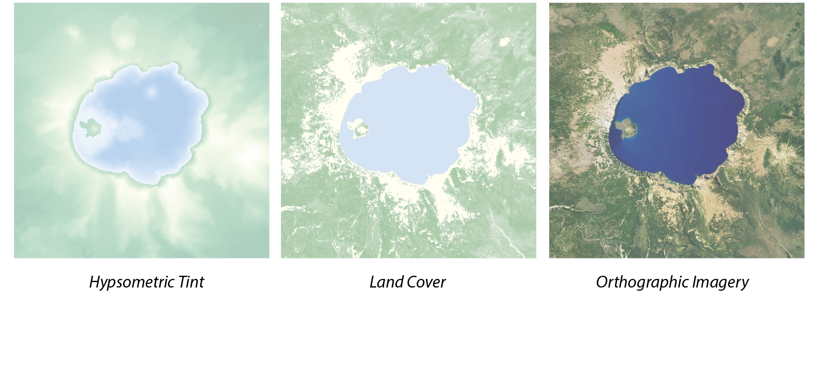
Thematic Terrain Elements
Hypsometric Tinting Thematic Landcover Orthoimagery
Notes:
I then created three thematic terrain elements
Hypsometric tinting – Imhof inspired Green to pale yellow and white to blue
Thematic Landcover - NLCD
Orthoimagery – google maps

Slide 15
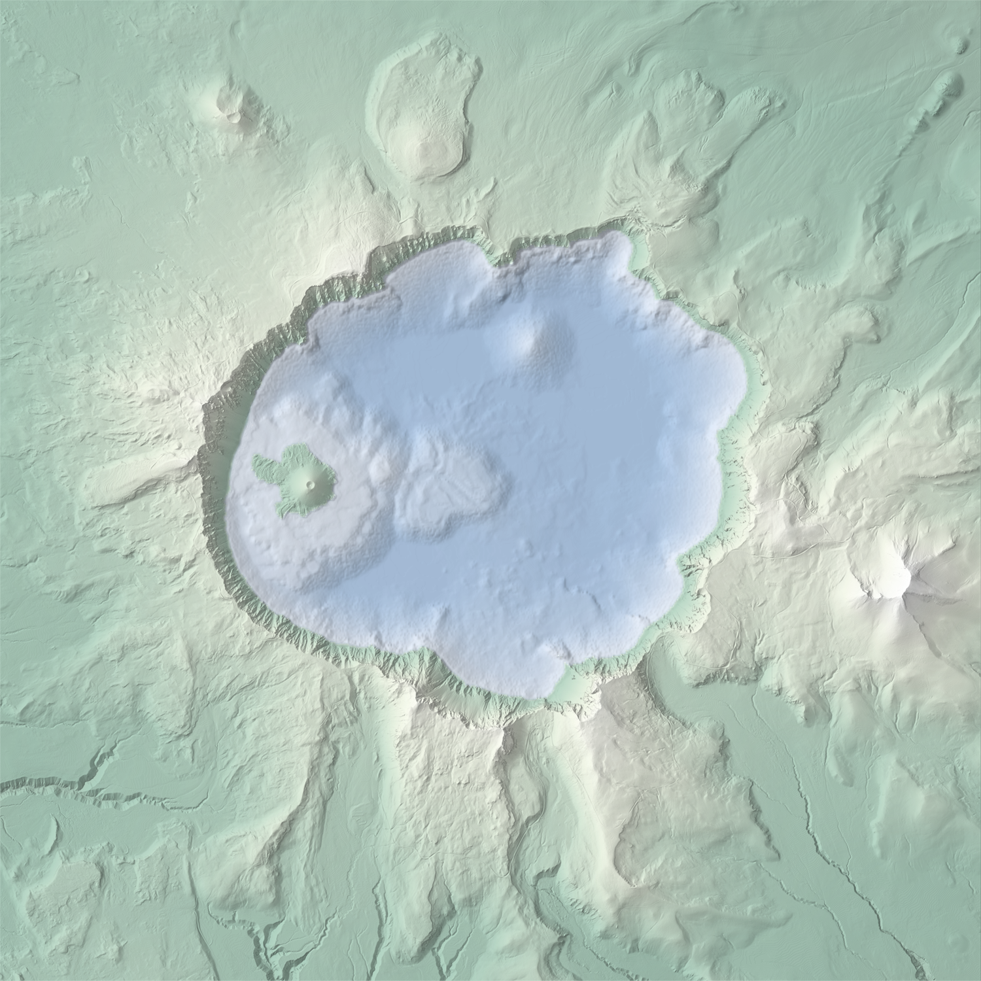
Terrain Maps
+
=
Notes:
Finally: Each shaded relief map was combined with a terrain overlay to create a terrain map like you see on the right

Slide 16
Terrain Maps
+
=
Notes:
BING!!

Slide 17
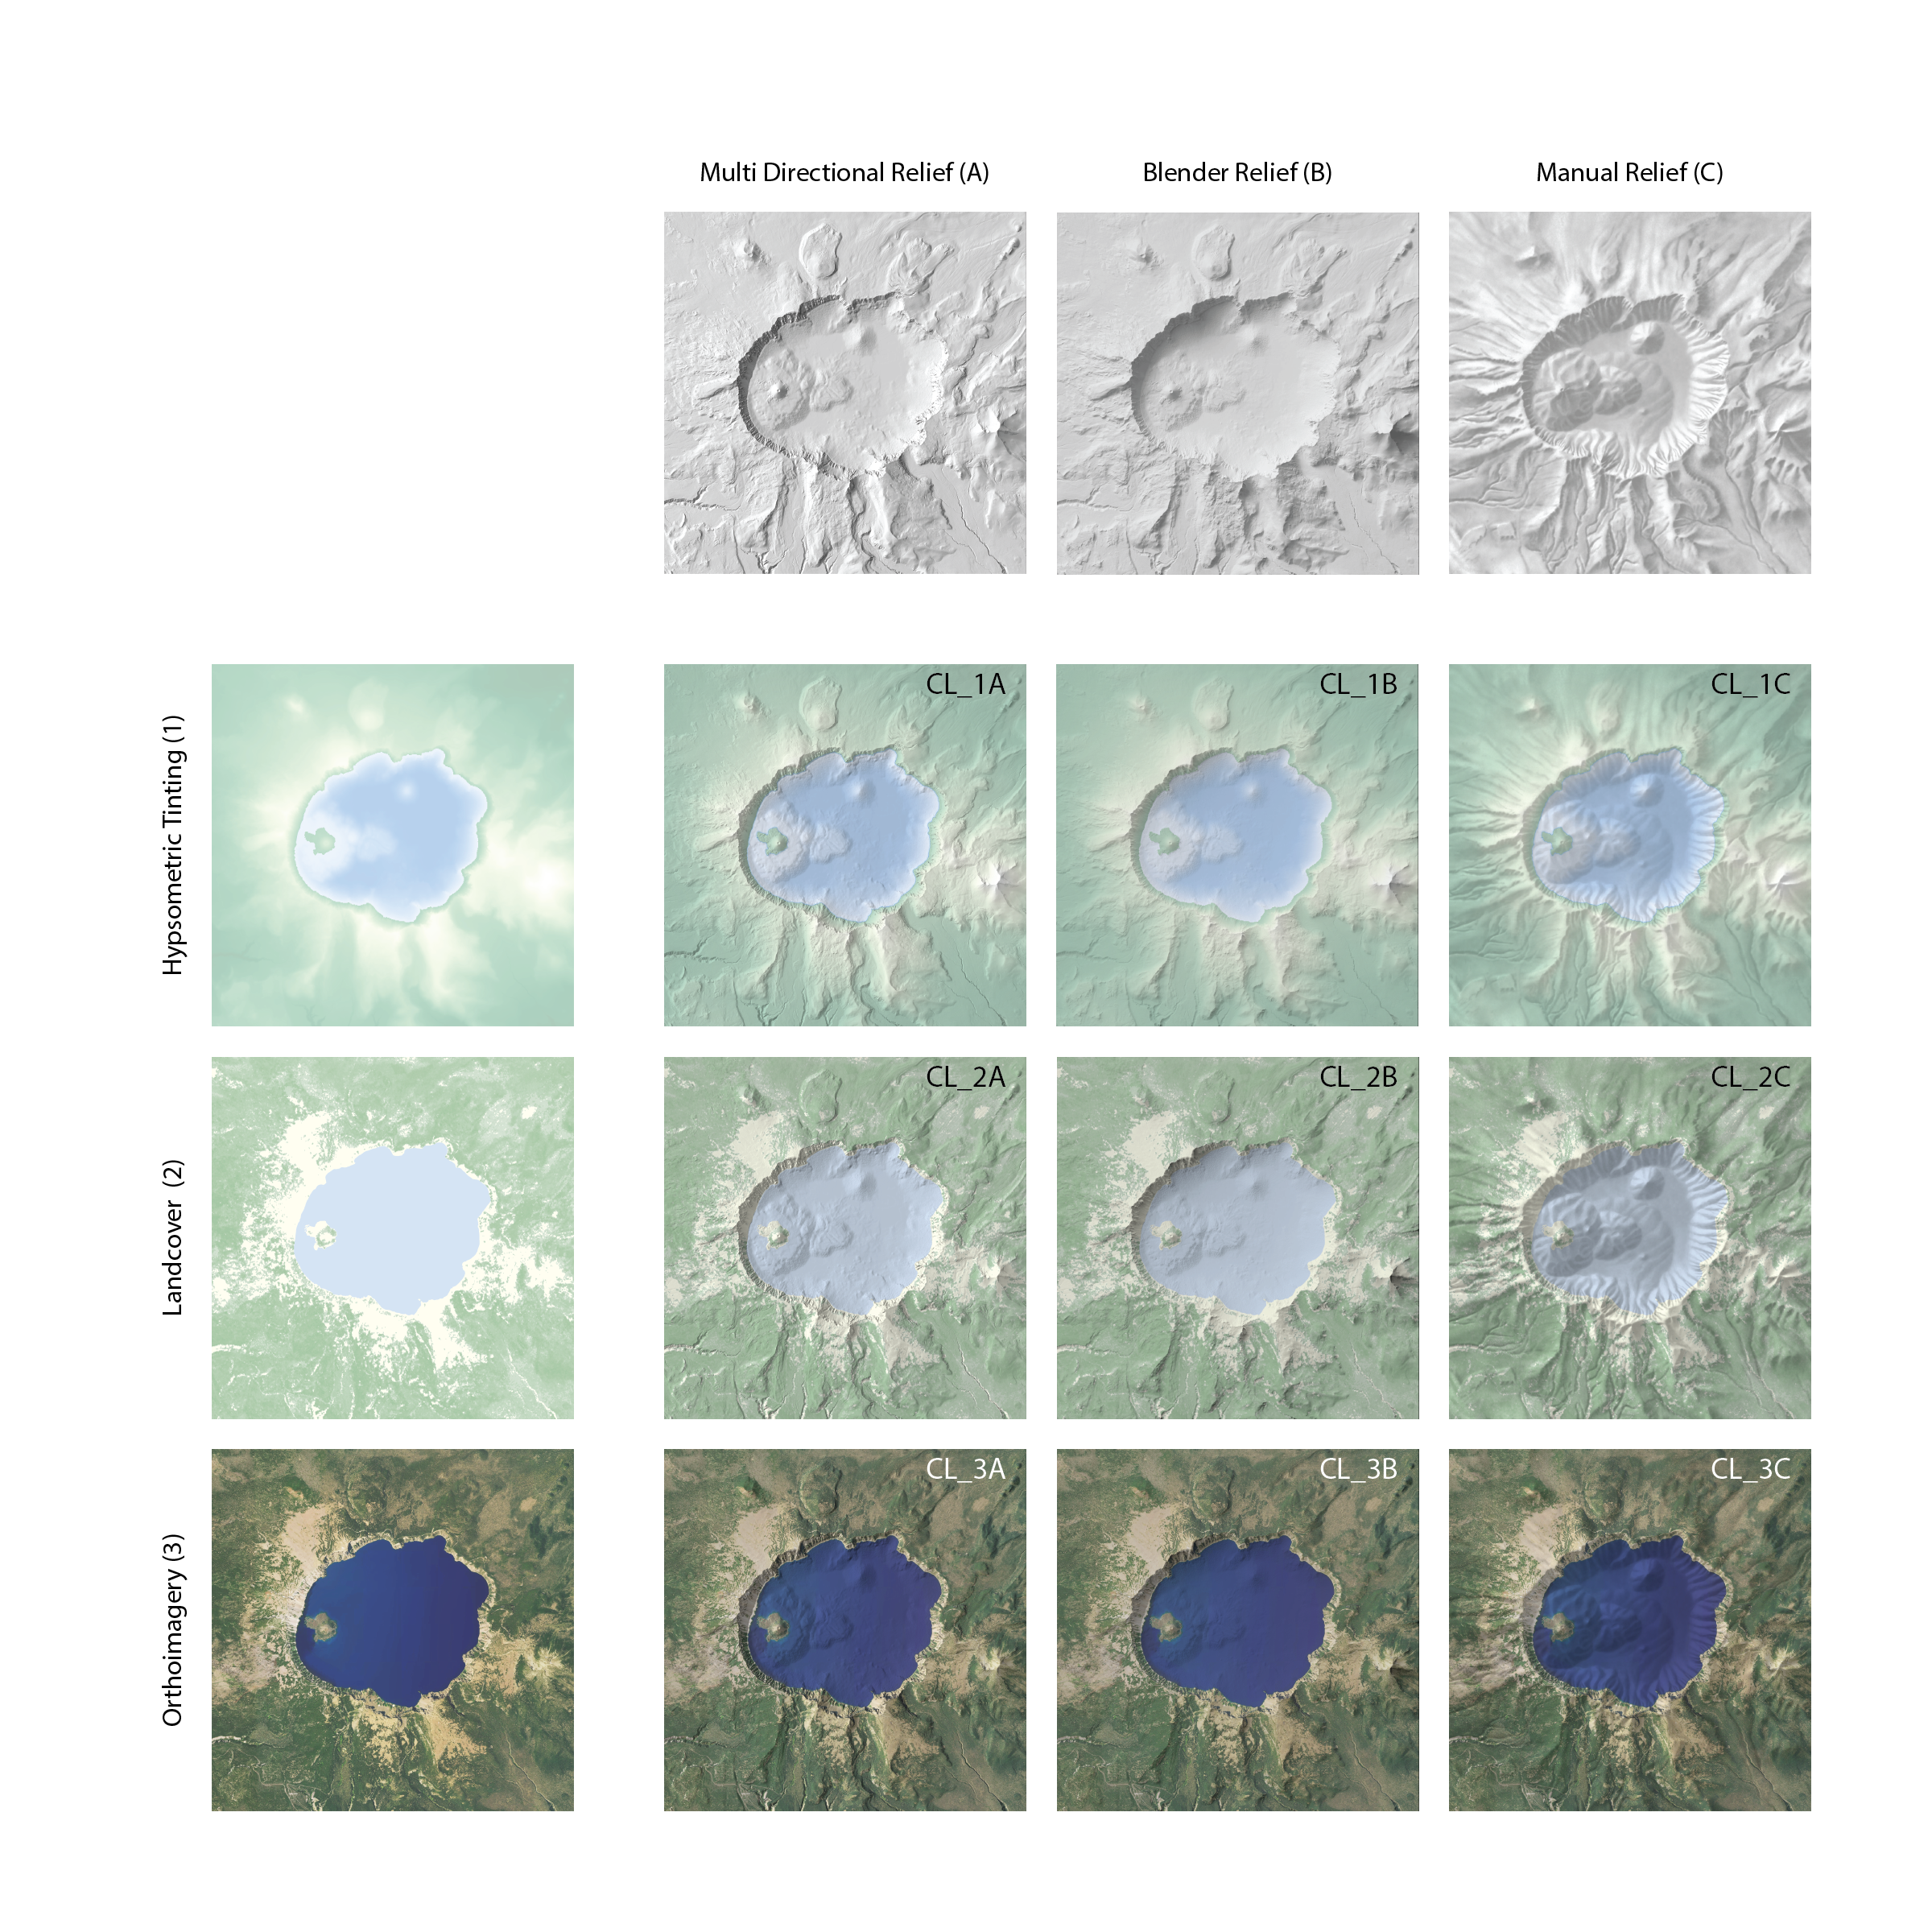
Shaded Relief
Thematic Terrain Elements
9 Terrain Maps
Notes:
As a result:
9 variations of crater lake were made
Using the three shaded relief techniques
Blended with each thematic terrain element
Participants will be randomly map individually and asked to complete a likert scale rating task

Slide 18
Part 1: Landform Rating Task
RQ1 - How do manual and analytical shaded relief techniques influence landform clarity in terrain maps that incorporate hypsometric tinting, landcover, and orthoimagery?
Participants will be asked to rank how clearly the three chosen landforms are represents.
Notes:
Getting back to my RQs:
To answer RQ1:
Shown a version of the map with physical geo labels
Asked to rank how clearly each of the three landforms are represented
Wizard Island
Mount Scott
Grouse Hill

Slide 19
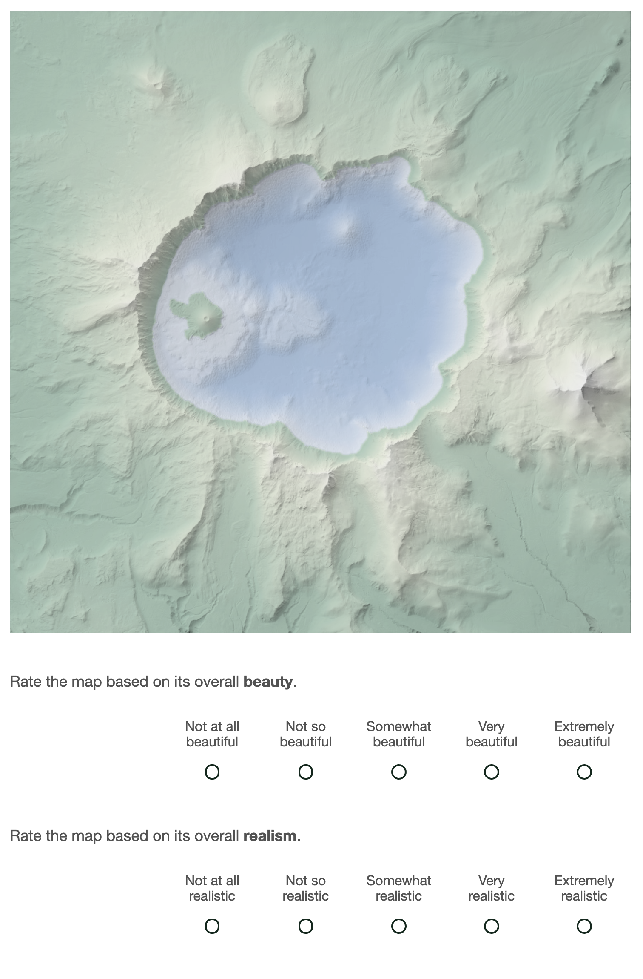
Part 2: Aesthetic Rating Task
RQ2 - How do manual and analytical shaded relief techniques influence reader aesthetic preference in terrain maps that incorporate hypsometric tinting, landcover, and orthoimagery?
Participants will be asked to rate the overall beauty and realism of each map
Notes:
Getting back to my RQs:
To answer RQ2:
Shown a version of the map with physical geo labels
Asked to rank how clearly each of the three landforms are represented
Wizard Island
Mount Scott
Grouse Hill

Slide 20
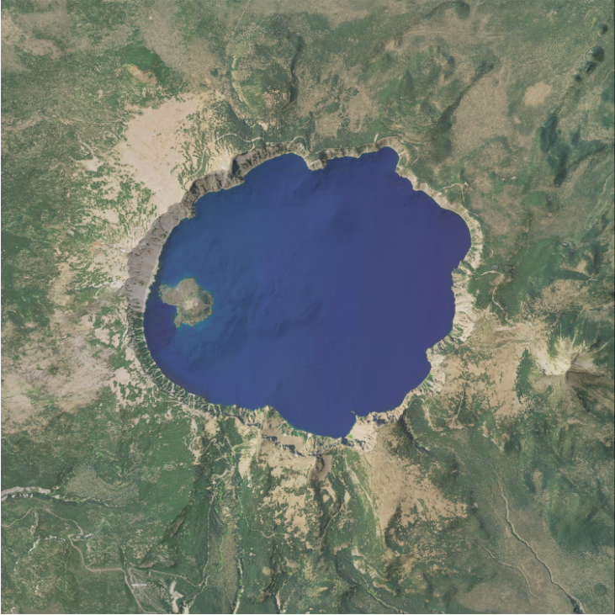
Results: Pilot Study
-24 University students
-Provided feedback on usability
-Promising initial results
Rated highest in beauty
Rated highest in realism
Hypsometric tint + Multidirectional Relief
Orthoimagery + Blender Relief
Notes:
Ran on 20 people – not enough to say anything about the data/stats
BUT was a good opportunity to get feedback on the usability and during the questions I would appreciate any additional feedback
Results showed ---> Highest rated for beauty was the multiD and Hypso while highest rated form realism awas Ortho and blender

Slide 21
Results: Pilot Study
Notes:
Most beneficial was the comments:
Most people couldn’t help but judge based on previous map
Some wished to see all maps ranked together – randomization helps create 81 different sequences
Unsure if this would be possible
A few people cought my typos and overall helped flush out my user study!

Slide 22
Methodology: Participants and Collection
Initial distribution: 100 participants
User study hosted on Qualtrics
Recruitment through Prolific
Participants will be compensated $5 for 15 minutes of their time
Notes:
NEXT week!!
The initial distribution of the survey is looking to capture a total of 100 responses. The survey in total is estimated to take 20 minutes, but no longer that 45 minutes. Participants will be compensated $5 for their time (.25 per minute).

Slide 23
Limitations and Future Research
Limitation: Qualitative user study
Future research: Test physiological and motor responses
Limitation: Conducted on novices
Future research: Comparing novice and experts in cartography
Notes:
Focus on why these methods
Way of looking at aesthetics
Clean up the thought process – make each section more concise
This research can become a teaching mechanism for conducting research around aesthetics and shaded relief. Since the research is aimed at participants with less than expert knowledge, the research also will provide those who partake with a chance to learn about a subject they may have little to no experience with.
This research is limited to the use of qualitative surveys being administered online but opens opportunities for future research to use in person tests to gauge physiological and motor responses to map design choices.
Another limitation is that experts in cartographic relief shading may provide differing results from the same study.
Future research could provide insight to differences in novice and expert opinions on aesthetics and landform clarity in relief shading.
- Since we see in high level award winning maps there are certain sophisticated techniques are becoming more prevelant

Slide 24
Conclusion
The results of this research ultimately aim to broadcast the use of user study-based experiments to assess the aesthetic and perceptual responses regarding terrain map design choices and landform clarity.

Slide 25
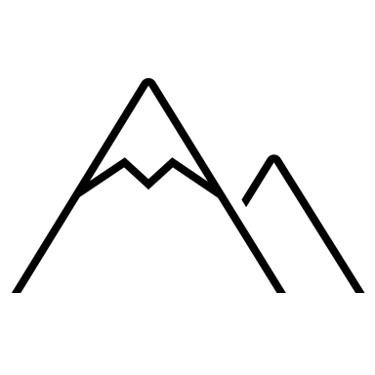
Thank you! Any feedback is greatly appreciated! Project funded by Dr. Carolyn Fish
Ndougla7@uoregon.edu
Twitter: @ndouglass7
Photo by James Fitzgerald on Unsplash

Slide 26
Methodology: Procedure
Section 1: Informed Consent
Section 2: Pre-test questionnaire
Section 3: Tutorial
Section 4: User Study
Shown each of the nine maps in a random order. A total of eighty-one different sequences of the nine maps.
For each map participants will complete two rating tasks
Section 5: Post-test questionnaire

