Slide 1
Geostatistical Analysis on COVID-19 Cumulative Confirmed Case and Fatality Based on County Level of Texas
Session: Spatial context, Human activities and space-time transmission of COVID-19
BY Xiu Wu 4/7/2021

Slide 2
objective
To pinpoint which social-economic, environmental impacts in Texas counties are more stimulated to COVID-19 case and death than other states.
Texas undergone 5 stages of COVID-19 risk-based guidelines
28 TEO,11 times PHDD
Stage 1
Stage 2
Stage 3
Stage 4
Stage 5
4/04
5/18
6/03
7/04
12/15

Slide 3
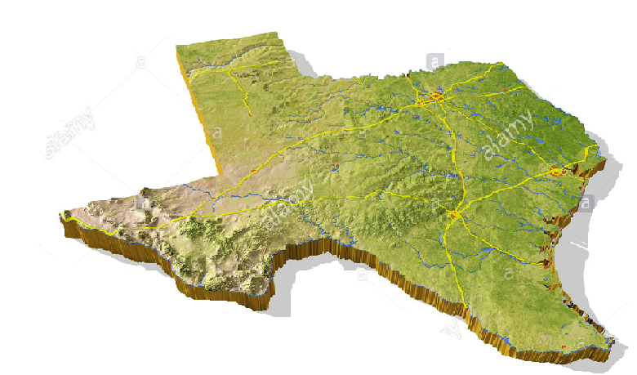
Study Framework
Season
4
3
2
1
CC number
Temporal pattern

Slide 4
Study Framework
Spatial Analysis Process

Slide 5
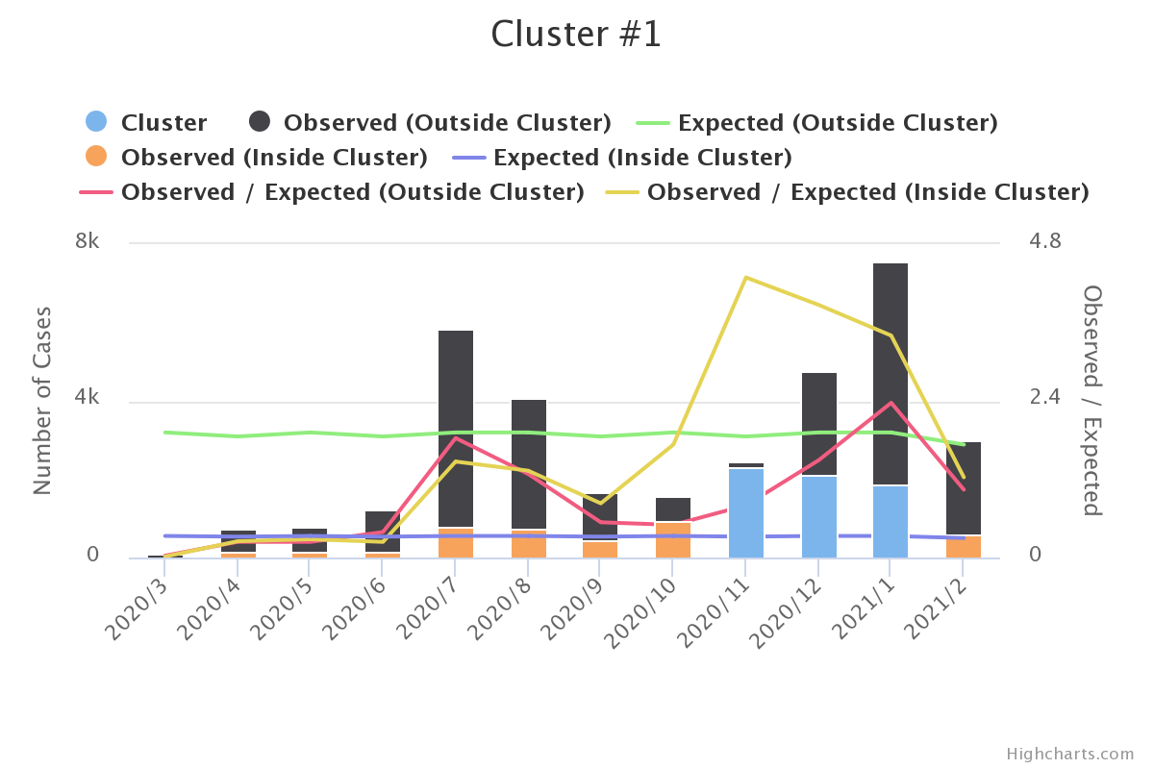
Space time Scan Statistics of Fatality

Slide 6
Correlation result
Explanatory Variables | CC Quarter 1 Coef. / Sig. | CC Quarter 2 Coef. / Sig. | CC Quarter 3 Coef. / Sig. | CC Quarter 4 Coef. / Sig.
Temperature |  | 0.128*/0.042 | 0.365**/0.000 | 0.292**/0.000
Participation |  | 0.307**/0.000 | 0.378**/0.000 | 0.325**/0.000
AQI |  | 0.021/0.744 | 0.249**/0.000 | 0.260**/0.000
Hospital bed | 0.645**/0.000 | 0.481**/0.000 | 0.495**/0.000 | 0.509**/0.000
Bed per capita
Population Density | 0.749**/0.000 | 0.570**/0.000 | 0.581**/0.000 | 0.600**/0.000
Land Area
Household Income | 0.335**/0.000
Total Population | 0.690**/0.000 | 0.512**/0.000 | 0.526**/0.000 | 0.541**/0.000
Black population | 0.243**/0.007 | 0.455**/0.000 | 0.398**/0.000 | 0.362**/0.000
unemployment |  | 0.161**/0.010 | 0.181**/0.004 | 0.165**/0.008
Male population
P20-59 | 0.467**/0.000 | 0.503**/0.000 | 0.474**/0.000 | 0.473**/0.000
P80 | -0.451**/0.000 | -0.501**/0.000 | -0.450**/0.000 | -0.399**/0.000

Slide 7
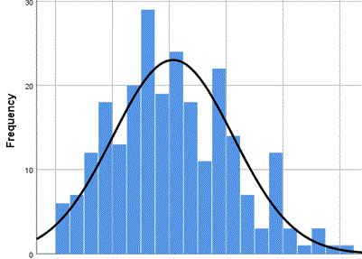
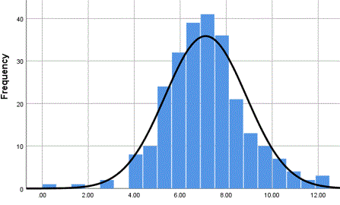
Selection of dependent variables –normal distribution
The First Season
The Second Season
The Third Season
The Last Season

Slide 8
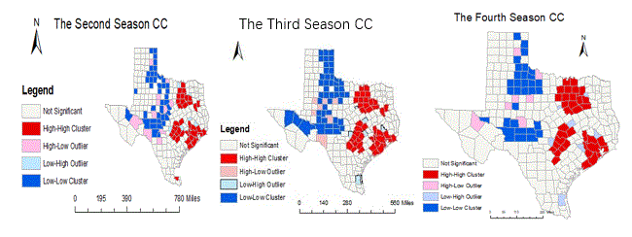
Spatial autocorrelation of CC
CC is remarkable and clustered.
CC is classified HH, LH, LH, and LL four clusters.

Slide 9
Selection of explanatory variables

Slide 10
Selection of explanatory variables
Principal Component Analysis (PCA)
No. | Items | Quarter 2 | Quarter 3 | Quarter 4
1 | Population and hospitalization | Factor1(THB, POD, TP) | Factor1(THB, POD, TP) | Factor1(THB, POD, TP)
2 | Age structure | Factor2(P59, P80) | Factor2(P59, P80) | Factor4(P59, P80)
3 | Air quality | Factor3(TPE, AQI) | Factor5(AQI)
4 | Economic | Factor4(PCI, UEM) | Factor4(PCI, UEM) | Factor2(PCI, UEM)
5 | Natural supply | Factor5(LA) | Factor3(LA) | Factor3(PCN, LA)
6 | Medical supply | Factor6(BPC) |  | Factor5(BPC)

Slide 11
Modeling OLS & GWR
GWR is superior to OLS for each parameter.
GWR models pass T test and F test.

Slide 12
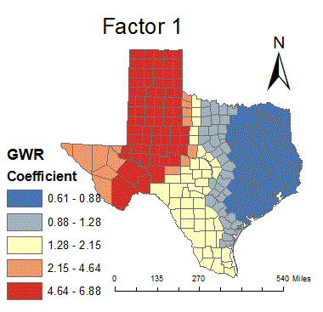
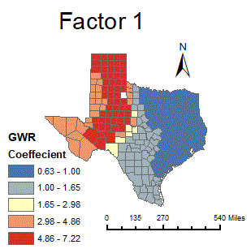
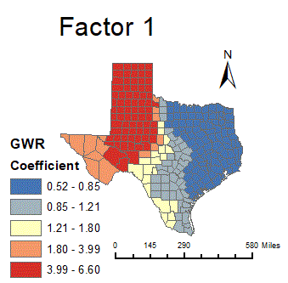
GWR Result analysis
Population and hospitalization(THB, POD, TP) are fixed.
Positively related to CC.
El Paso, Odessa, Midland, and Randall (73counties) are the most severe areas.
The Second Season
The Third Season
The Last Season
The Second Season

Slide 13
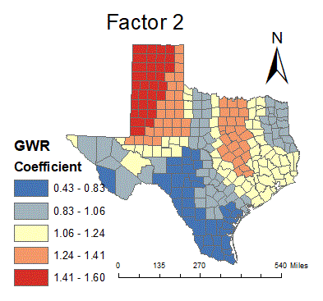
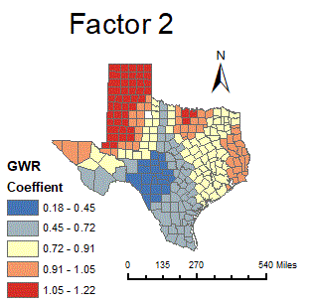
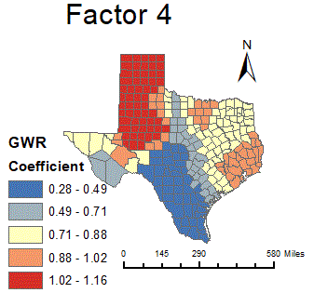
GWR Result analysis
Age structures (P59,P80) are positively stable impacts on CC.
The polarization in two opposite aspects is extended.
The Second Season
The Third Season
The Last Season

Slide 14
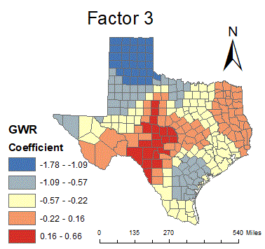
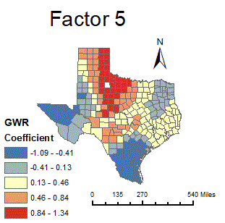
GWR Result analysis
Air quality (TPE, AQI) is flexible.
Air quality impacts are ignored in the fourth quarter.
The Second Quarter
The Third Quarter

Slide 15
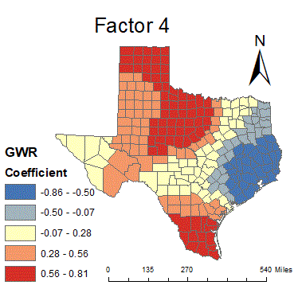
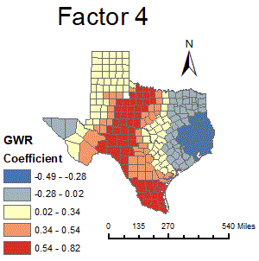
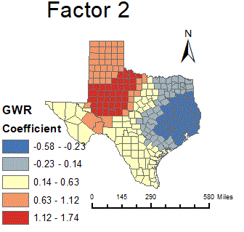
GWR Result analysis
Economic (PCI, UEM) impacts are fluctuated and reduced from -0.86-1.74.
The Second Quarter
The Third Quarter
The Last Quarter

Slide 16
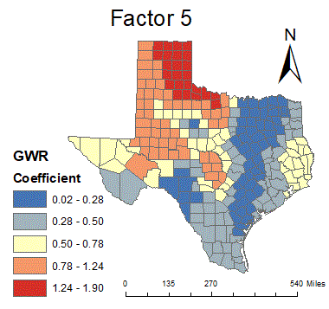
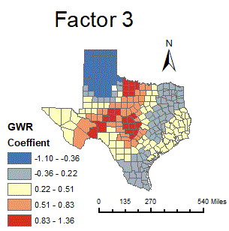
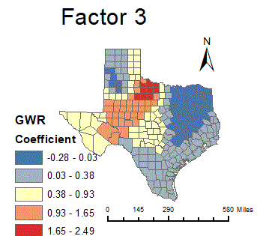
GWR Result analysis
Natural supply (LA) impacts are decreased and fluctuated.
The Second Quarter
The Third Quarter
The Last Quarter

Slide 17
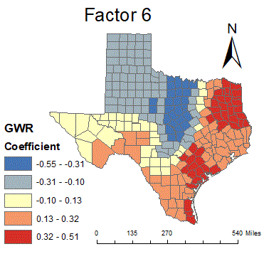
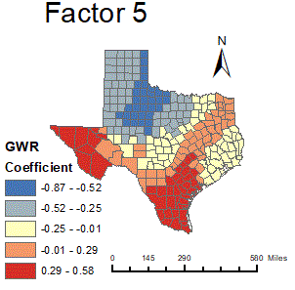
GWR Result analysis
Medical care (BPC) impacts are increased and fluctuated.
The Second Quarter
The Last Quarter

Slide 18
Finding
1. The most sensitive area of CC in Texas is El Paso, Odessa, Midland, Lubbock and Amarillo.
2. 20-59 population infections are more than the elder.
3. Race impacts are less than other factors.
4. The last quarter is the most sensitive period.

Slide 19
Conclusion
Limitations
Focus on Texas Covid-19 scenario, the application is limited.
Lacking chronic disease metrics underpin the research.
Implications
It is beneficial for local government and CDC to make appropriate and scientific judgments.

Slide 20
Thank you!

