Slide 1
The collective intelligence of microbes: beyond SETI
Dr Alessandra Marino
Resrearch Fellow in Geography and AstrobiologyOU
Alessandra.marino@open.ac.uk

Slide 2
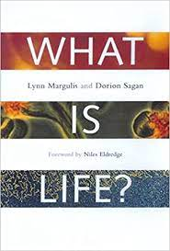
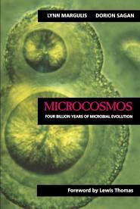
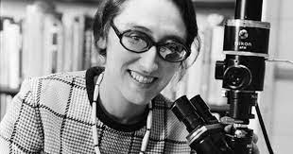
Lynn Margulis

Slide 3
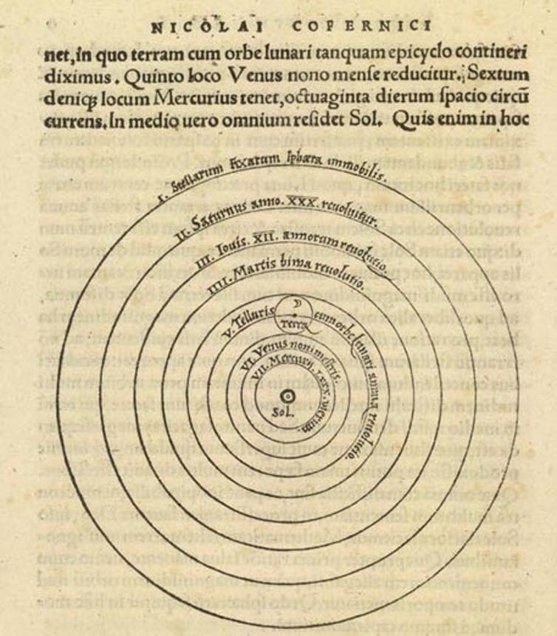

Slide 4
“Intelligence and technology, incubated by humankind, are really the property of the microcosm” (Margulis 1997, 36)
“even if all anthropoids became extinct, the microcosm would still abound in those assets (nervous system, manipulative assemblages) that were leveraged into intelligence and technology... Given time to evolve in the absence of people, the descendants of racoons – clever, nocturnal animals with good manual coordination – could start their own space program” (236)
“The ironic end result of all our extragenetic intelligence is precisely the further preservation of the genes. At the present time, intelligence seems to be a key mode of survival” (242)

Slide 5
Hellingwerf, K. J., Postma, P. W., Tommassen, J., and Westerhoff, H. V. (1995) Signal-transduction in bacteria – phospho-neural network(s) in Escherichia coli. FEMS Microbiol. Rev. 16, 309–321.
Ben Jacob E, Becker I, Shapira Y, Levine H. (2004) Bacterial linguistic communication and social intelligence. Trends Microbiol. Aug;12(8), 366-72.
Westerhoff HV, Brooks AN, Simeonidis E, et al. (2014) Macromolecular networks and intelligence in microorganisms. Front Microbiol. 5. 375
Communication
Responses
Problem-solving

Slide 6
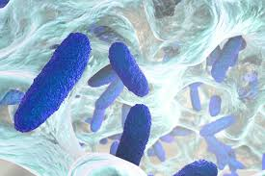
Quorum Sensing
Biofilms
Cannibalism
Altruism

Slide 7
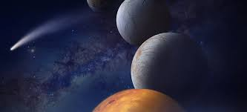
Why does microbial intelligence matter for the ethics of astrobiology?
The spatiality of life detection
notions of ‘intelligence’ permeate discourses on extra terrestrial life, with the effect of reinforcing hierarchies and specific notions of evolution back on Earth.

Slide 8
What if one characteristic of a really advanced intelligence is to become less and less distinguishable from natural phenomena?
Kim Stanley Robinson, Aurora

